Slide 1

Fall 2021 “AAP” Meeting
Friday, October 15, 2021

Slide 2
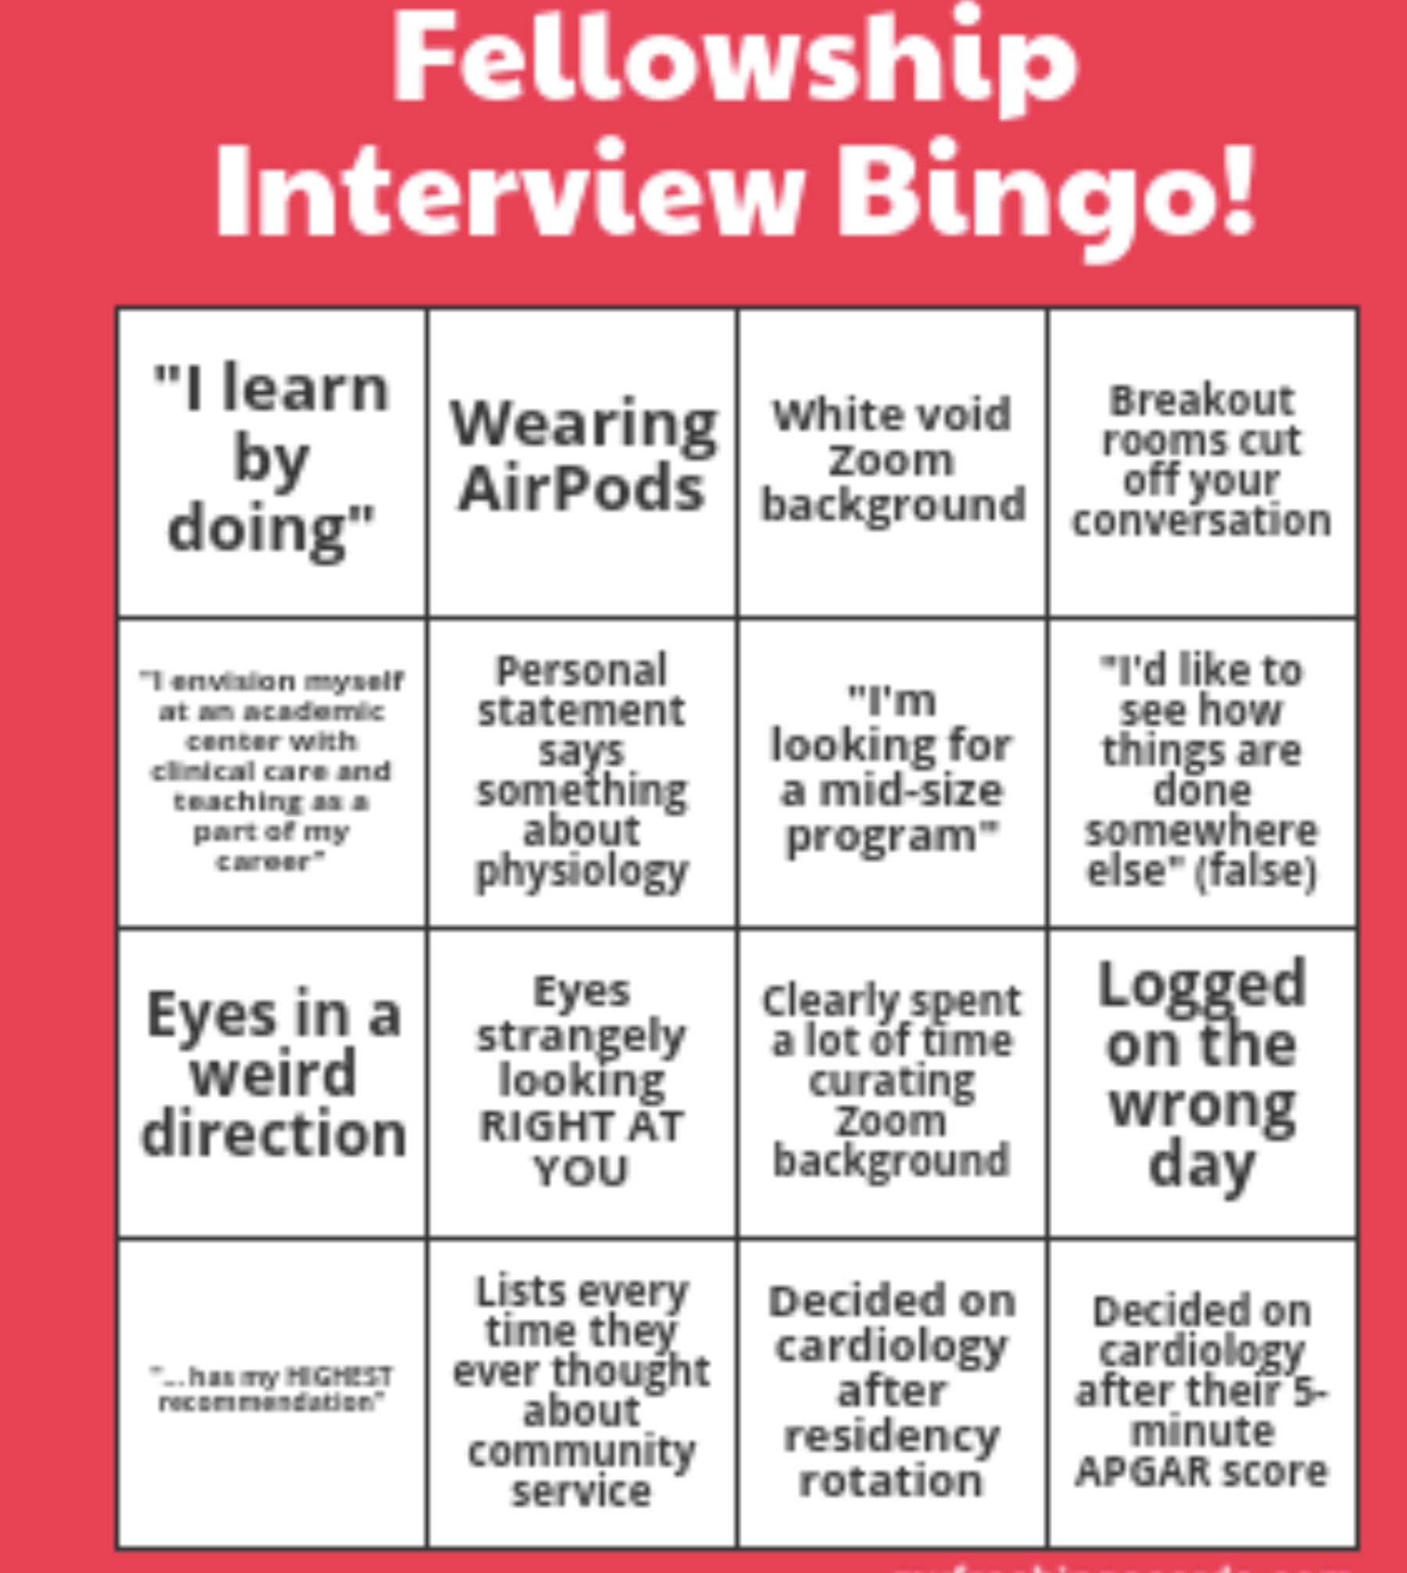

Slide 3
Agenda
Announcements and updates
  Election results and new board positions (LF)
  Match move for December 2022 (LF)
  Treasurer report (SE)
  AAP-SPCTPD Trainee workshop – 10/29 (LF)
Exercise guidelines – Jen Huang, Brad Robinson
Recruiting trends (LF)
DEI task force - Carly Fifer
Mixed methods study of virtual interviewing – David Werho
4th year application process – Sinai Zyblewski
APPD SPIN – rep needed
CoPS update – David Brown/Rob Ross
  Workforce information
  EPA framework for initial certification by ABP
  Milestones 2.0 – ACGME
  CoPS/COPMSEP/APPD fellowship recruitment to residents and medical students
Next meeting(s)

Slide 4
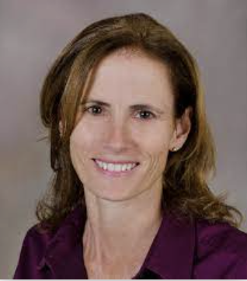
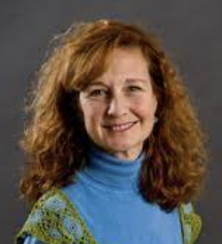
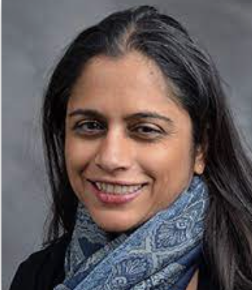
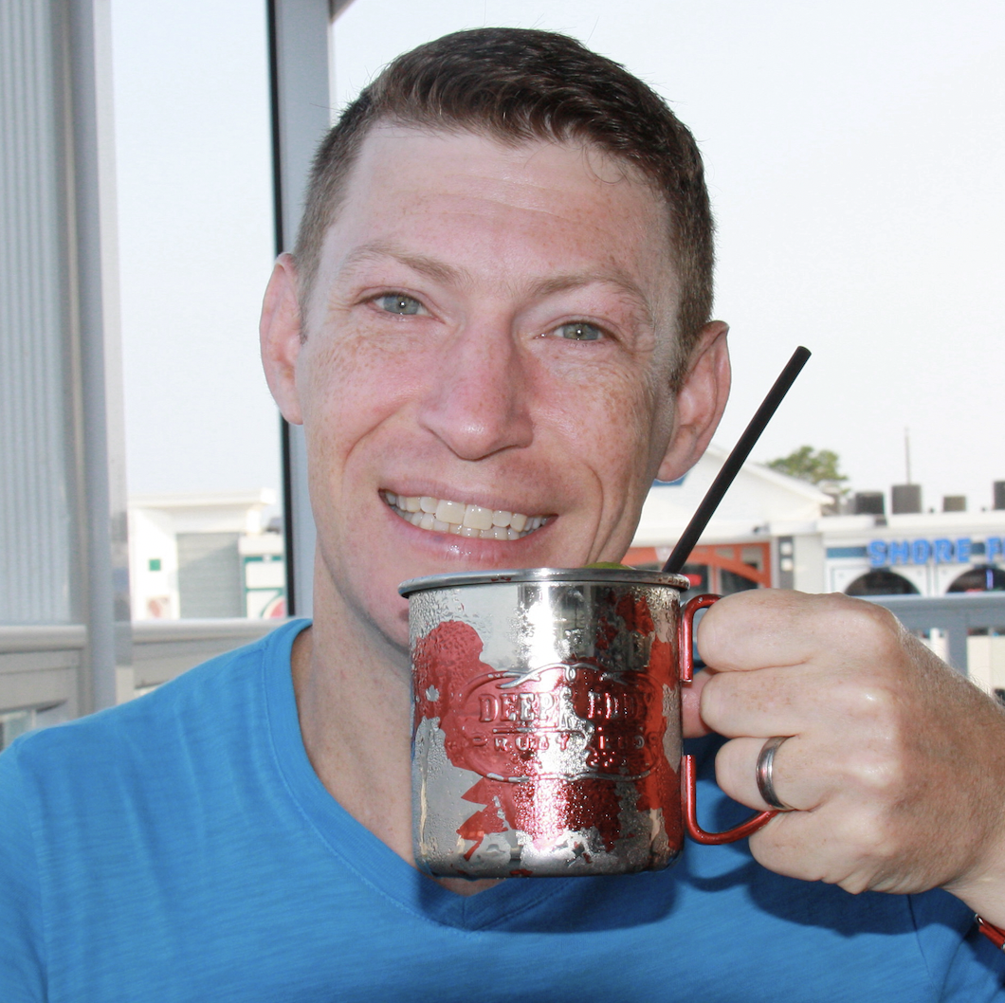
2021 – 2023 SPCTPD Board
President: Laurie Armsby
Doernbecher Children’s Hospital/OHSU Portland, OR
Vice-President: Susan Etheridge
Primary Children’s Hospital Salt Lake City, UT
Secretary/Treasurer: Rupali Gandhi
Advocate Children’s Hospital
Chicago, IL
Past-President/CoPS rep: Lowell Frank
Children’s National Hospital
Washington, DC

Slide 5
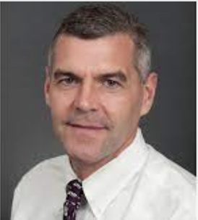
Thank you!!!
Past president and CoPS rep 2019-2021
Past president and CoPS rep 2017-2019
President 2015-2017
Vice-President 2013-2015
Secretary/Treasurer 2011-2013
10 years as PD

Slide 6
Agenda
Announcements and updates
  Election results and new board positions (LF)
  Match move for December 2022 (LF)
  Treasurer report (SE)
  AAP-SPCTPD Trainee workshop – 10/29 (LF)
Exercise guidelines – Jen Huang, Brad Robinson
Recruiting trends (LF)
DEI task force - Carly Fifer
Mixed methods study of virtual interviewing – David Werho
4th year application process – Sinai Zyblewski
APPD SPIN – rep needed
CoPS update – David Brown/Rob Ross
  Workforce information
  EPA framework for initial certification by ABP
  Milestones 2.0 – ACGME
  CoPS/COPMSEP/APPD fellowship recruitment to residents and medical students
Next meeting(s)

Slide 7
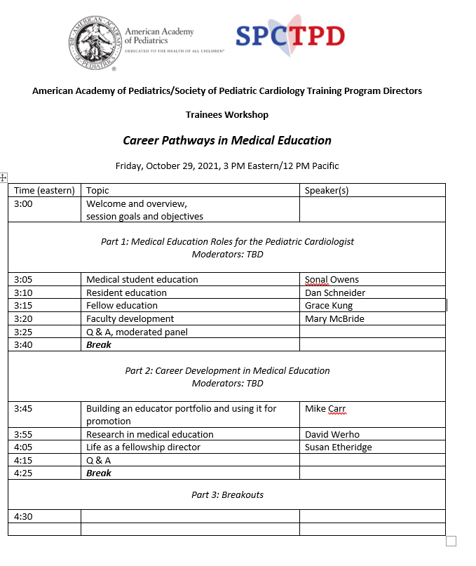
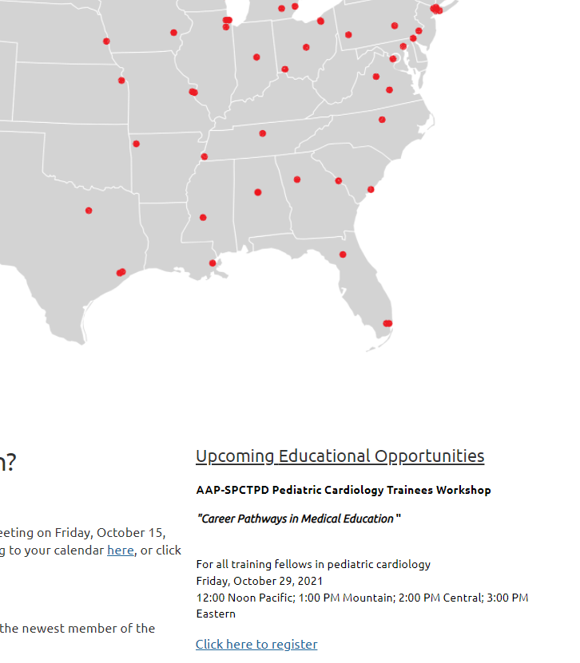

Slide 8
Pediatric Cardiology Fellowship Training Recommendations for Exercise Physiology
Presented by: The Pediatric Cardiology Exercise Medicine Core Curriculum Committee (PCEMCC) in collaboration with Heart University
Jennifer Huang, MD, MCr (she/her)
Bradley Robinson, MD (he/him)

Slide 9
Introduction
Why is training in exercise needed?
Not adequately addressed in prior guidelines
Notes:
Why is training in exercise needed?
Not adequately addressed in prior guidelines

Slide 10
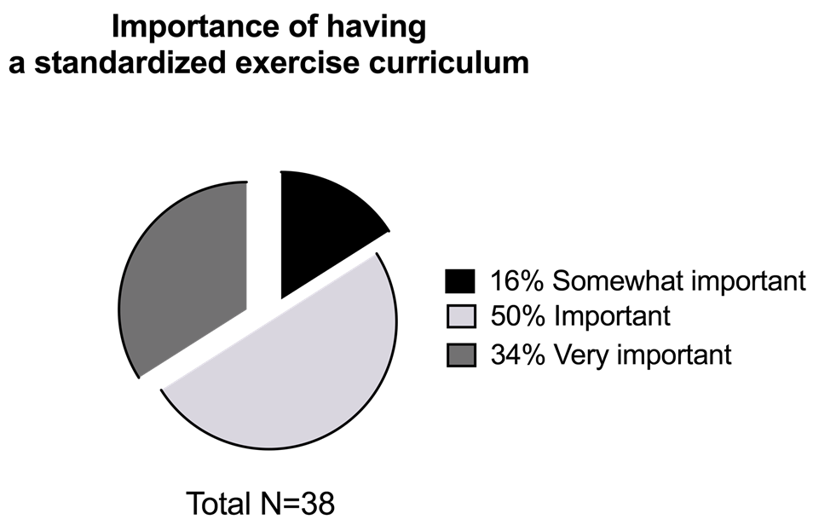
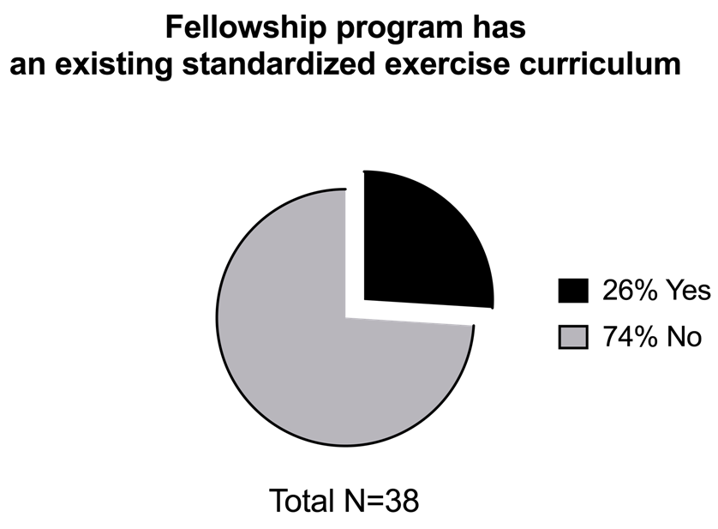
We did a Needs Assessment
Survey of Pediatric Cardiology Fellowship Directors and exercise physiologists
38 participants (~60% response rate)
Notes:
A group of pediatric cardiologists put together a needs assessment in 2020 in which we surveyed fellowship program directors and exercise physiologists about training in exercise physiology
Of the programs 38/63 were represented accounting for a 60% response rate
While 84% of programs thought it was important to very important to have an existing standardized exercise curriculum (as shown on the pie chart on left), only 26% of the responders had a standardized curriculum in place (pie chart on right)
To address this…

Slide 11
Who is the Pediatric Cardiology Exercise Medicine Curriculum Committee (PCEMCC)?
Group of pediatric cardiologists focused on exercise, exercise physiologists, and program directors
Gathered to create recommendations for exercise training curricula
Self-tasked to provide educational materials to facilitate learning and competency in exercise physiology
Notes:
To address this, we formed the PCEMCC or pediatric cardiology exercise medicine curriculum committee
Which includes a group of pediatric cardiologists focused on exercise, exercise physiologists, and program directors
We then gathered to create recommendations for exercise training curricula
And were self-tasked to provide educational materials to facilitate learning and competency in exercise physiology
This lecture series partially fulfills those needs with a plan for it to be available online through Heart University and the Society of Pediatric Cardiology Program Directors website

Slide 12
The Pediatric Cardiology Exercise Medicine Core Curriculum Committee (PCEMCC)
Danielle S. Burstein, MD – Children’s Hospital of Philadelphia, Philadelphia, PA
Michael R. Carr, MD – Ann & Robert H. Lurie Children's Hospital of Chicago, Chicago, IL
Tracy Curran, PhD – Boston Children’s Hospital, Boston, MA
Naomi Gauthier, MD – Boston Children’s Hospital, Boston, MA
Jesse Hansen, MD – C.S. Mott Children’s Hospital, University of Michigan Health, Ann Arbor, MI
Jennifer Huang, MD - Doernbecher Children’s Hospital, Oregon Health and Science University, Portland, OR
Peter R. Koenig, MD - Ann & Robert H. Lurie Children's Hospital of Chicago, Chicago, IL
Alissa Lyman, PA-C – Doernbecher Children’s Hospital, Oregon Health and Science University, Portland, OR
Wayne Mays, MS – Cincinnati Children’s Hospital Medical Center, Cincinnati, OH
Alexander “Sasha” Opotowsky, MD, MMSc – Cincinnati Children’s Hospital Medical Center, Cincinnati, OH
William B. Orr, MD – St. Louis Children’s Hospital, Washington University School of Medicine, St. Louis, MO
Stephen Paridon, MD – Children’s Hospital of Philadelphia, Philadelphia, PA
Tam Dan “Tina” Pham, MD – Texas Children’s Hospital, Houston, TX
Adam Powell, MD – Cincinnati Children’s Hospital Medical Center, Cincinnati, OH
Jonathan Rhodes, MD – Boston Children’s Hospital, Boston, MA
Bradley Robinson, MD - Nemours Alfred I. duPont Hospital for Children, Wilmington, DE
Meg Vernon, MD – Seattle Children’s Hospital, University of Washington, Seattle, WA
Kendra Ward, MD – Ann & Robert H. Lurie Children's Hospital of Chicago, Chicago, IL
David A. White, PhD – Children's Mercy Hospitals and Clinics, Ward Family Heart Center, Kansas City, MO
Notes:
Here are the members of the PCEMCC including the 3 of us and which includes specialists from 12 different academic institutions.

Slide 13
Training and Testing Methods
Providing recommendations for training and competencies in exercise physiology
Publishing an online lecture series
Creating an online repository of exercise tests for review
Establishing testing methods to assess competency
Notes:
The PCEMCC created a strategy by
a. Providing recommendations for training and competencies in exercise physiology in the form of a published document
b. Publishing this online lecture series
c. A goal of ours to create an online repository of exercise tests for review
d. Lastly, we have a goal of establishing testing methods to assess competency
Overall, we want to provide a training curriculum that we can offer to all pediatric cardiology fellows regardless of institution that can be done independently and achieve competency in exercise physiology.

Slide 14
Online Lecture Series
Available on-line at Heart University and SPCTPD.org
Mastery learning approach
Target audience is Pediatric Cardiology Fellows
Notes:
The lecture topics include:
1. Clinical Utility of Exercise Training
2. Biochemistry of exercise
3. Oxygen delivery
4. Ventilation and C02 elimination (external respiration)
5. Exercise Hemodynamics Ie what happens to cardiac output
6. Basics of exercise electrophysiology
7. Exercise equipment and protocols
8. Cardiac rehab in pediatrics
9. Exercising with a pacemaker
10. A demonstration of how a patient is exercised (a real patient)
With those broad goals in education, let’s discuss exercise testing
Taken from :
Others will1. Why is Exercise Testing a Valuable Tool in Pediatric Cardiology? Jennifer Huang (huangje@ohsu.edu), Bradley Robinson (bradley.robinson@nemours.org), Peter Koenig (pkoenig@luriechildrens.org)
2. Basic of Exercise Biochemistry. Jonathan Rhodes (jonathan.rhodes@cardio.chboston.org), Naomi Gauthier (naomi.gauthier@cardio.chboston.org), Meg Vernon (meg.vernon@seattlechildrens.org)
3. Basic of Oxygen Delivery to Tissues. Sasha Opotowsky (sasha.opotowsky@cchmc.org), Naomi Gauthier (naomi.gauthier@cardio.chboston.org), David White (dawhite@cmh.edu)
4. Basics of Exercise Ventilation and CO2 Elimination. Sasha Opotowsky (sasha.opotowsky@cchmc.org), Jonathan Rhodes (jonathan.rhodes@cardio.chboston.org), Meg Vernon (meg.vernon@seattlechildrens.org)
5. Basics of Exercise Hemodynamics. Wayne Mays (wayne.mays@cchmc.org), Jonathan Rhodes (jonathan.rhodes@cardio.chboston.org), Meg Vernon (meg.vernon@seattlechildrens.org)
6. Basics of Exercise Electrophysiology. Tina Pham (tamdan.pham@bcm.edu), Kendra Ward (kward@luriechildrens.org)
7. Exercise Testing Equipment and Protocols. Wayne Mays (wayne.mays@cchmc.org), Steve Paridon (stephensp@email.chop.edu), Tracy Curran (tracy.curran@cardio.chboston.org)
Supplemental Lectures:
8. Center Videos. Steve Paridon (stephensp@email.chop.edu)
9. Cardiac Rehab. Naomi Gauthier (naomi.gauthier@cardio.chboston.org), Tracy Curran (tracy.curran@cardio.chboston.org), Danielle Burstein (bursteind@email.chop.edu), Sam Wittekind (samuel.wittekind@cchmc.org)
10. Exercise Testing in Patients with a Pacemaker/ICD. Kendra Ward (kward@luriechildrens.org)
cover .

Slide 15
Guidelines
Are divided in 2 sections:
  Core Training
  Advanced Training

Slide 16
Expected Core Curricular Competencies
Medical Knowledge: The graduating core fellowship trainee demonstrates:
Knowledge of the basics of cellular energy metabolism including the importance of ATP and the energy systems to create it (aerobic and anaerobic).
Knowledge of the role of cardiac and pulmonary function in oxygen delivery and carbon dioxide removal.
Understanding of the normal and pathological ventilatory and hemodynamic responses to aerobic and anaerobic exercise commonly encountered in pediatric cardiology practice (see Appendix 1)
Ability to recognize the primary limitation to further exercise.
Recognition of normal and pathologic cardiac rhythms during exercise (e.g., premature atrial contractions, supraventricular tachycardia, complete heart block, premature ventricular contractions, ventricular tachycardia, torsade de pointes, pacemaker response) and their implications for clinical care.
Recognition of normal and pathologic changes in electrocardiographic morphology (e.g., ST changes, T wave changes, etc.).
Understanding of distinct cardiovascular effects of dynamic and static physical work.
Knowledge of how cardiovascular drugs impact exercise performance, hemodynamics, and the electrocardiogram (e.g., beta blockers, digoxin, systemic and pulmonary vasodilator medications).
Understanding the principles of ECG-focused, imaging-focused, and cardiopulmonary exercise testing.
Understanding of the basic principles of exercise training and physical activity promotion, and the differences between these concepts.

Slide 17
Core Training
Evaluation Tools: direct observation, conference participation, procedure logs, and in-training examination, written test: multiple choice question
Patient Care and Procedural Skills: The graduating core fellowship trainee demonstrates:
Knowledge of indications for pediatric basic (ECG-only) testing.
Knowledge of the indications for pediatric cardiopulmonary exercise testing (CPET).
Knowledge of when the additional data from stress echocardiography, exercise flow volume loops, pre- and post-spirometry or other modalities may provide useful clinical information.
Knowledge of the appropriate modality of basic exercise testing or CPET for specific pre-test diagnoses and cardiac conditions, and the appropriate testing options within each modality (cycle vs treadmill, incremental vs ramp protocol).
Knowledge of the relative and absolute contraindications to maximal exercise testing.
Knowledge of risk of serious events occurring during exercise (to obtain consent from patient and/or parents
Knowledge of safety reasons for termination of exercise testing.
Knowledge of treatments for complications of exercise testing including PALS/BLS based code-management.
Knowledge of best practices for monitoring during a maximal exercise test (ECG, heart rate, blood pressure, pulse oximetry).
Proper ECG lead placement, skin preparation and need for obtaining supine, seated, and hyperventilation ECG prior to testing.
Skill of pediatric exercise testing interpretation, both ECG focused, imaging focused, and cardiopulmonary tests.
Ability to apply standard testing and CPET results to patient management.
Interpretation and understanding of sports classification systems and appreciation of the range of published exercise guidelines
Evaluation Tools: direct observation, conference participation, multiple choice questions, and procedure logs (Appendix 4)

Slide 18
Table 2. Minimal procedural experience in pediatric exercise testing, for general pediatric cardiology fellows (Online or In-Person)
_____________________________________________________________________________________
Procedure “Core” Suggested No. of Procedures
_____________________________________________________________________________________
Exercise Electrocardiograms 45
Observed Treadmill or Cycle Ergometer Basic (ECG) Testing 3
Observed Stress Imaging (Echocardiography, Stress Magnetic Resonance Imaging, 2 or Stress Nuclear Imaging)
Interpretation of Treadmill or Cycle Ergometer Basic ECG and imaging-based testing data 40
Cardiopulmonary Exercise Tests 12
Observed Treadmill or Cycle Ergometer Cardiopulmonary Exercise Test 2
Interpretation of Treadmill or Cycle Ergometer Cardiopulmonary Exercise Test Data 10

Slide 19
Advanced Training Curricular Components
All competencies demonstrated in Table 1 with the addition of the following:
List various exercise protocols (e.g., ramp vs incremental), modalities (cycle vs treadmill) and indications for each.
Interpret and report pediatric exercise electrocardiogram testing.
Interpret and report pediatric CPET.
Understand distinctions in the interpretation of CPET responses and specific variables for different types of congenital heart disease and other pediatric heart disease.
Demonstrates knowledge of the range of exercise test abnormalities that may be encountered in patients with common congenital and acquired heart defects, pulmonary hypertension, metabolic defects, electrophysiological diseases, etc.
Demonstrates understanding of the cardiovascular adaptations to aerobic and anaerobic training (e.g., runners, weightlifters, sprinters, slow-twitch, fast-twitch muscles).
Understand how to write an exercise prescription.
Understand how to incorporate an exercise prescription into exercise training.

Slide 20
Minimal Procedural Experience to Assess Competency for Advanced Providers
Procedure “Core” Suggested No. of Procedures
________________________________________________________________
Observed or Interpreted Exercise Electrocardiograms 200
Treadmill or Cycle Standard (ECG only) Testing 150
Stress Imaging (Echo, MRI, or nuclear) 50
Observed or Interpreted Cardiopulmonary Exercise Tests
Treadmill or Cycle Cardiopulmonary Exercise Test (CPET) 100

Slide 21
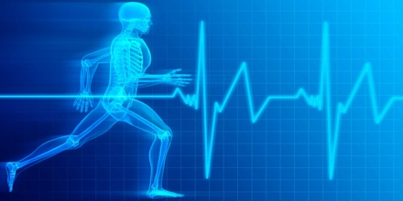
Slide 27
Questions
Notes:
Sample questions here. (Feel free to add some from your slides)
Eg Where would you exercise a patient with a pacemaker that is in the DDDR mode?
A: treadmill ***
B bike ergometer
C with dobutamine
Examples of stressors used for exercise testing include all of following except:
Treadmill
Bicycle ergometer
Dobutamine
ECG***

Slide 22
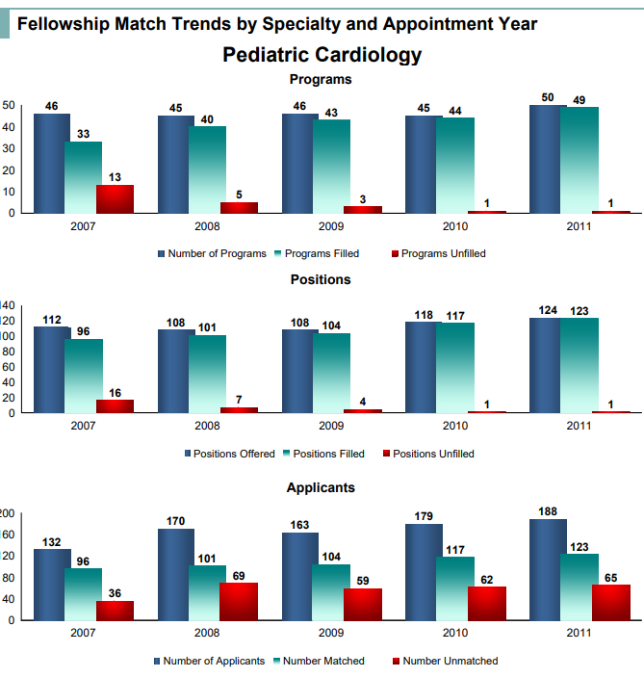
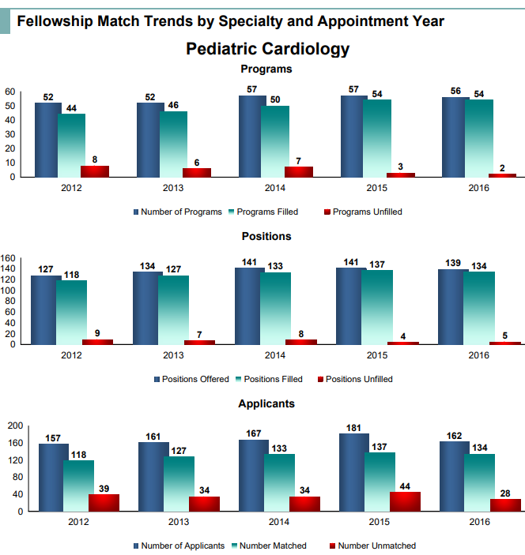
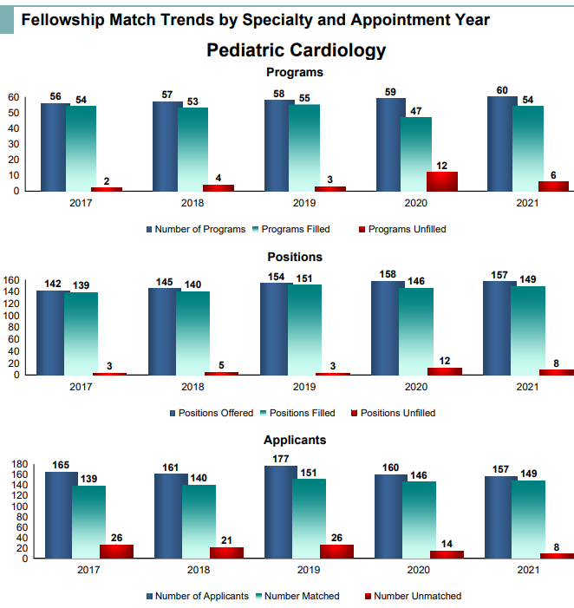
Recruiting trends
For 2022 appointment year, 186 applicants
  Was 171 in 2021
  177 in 2020
  195 in 2019
18 – 21 apps per US MD application (33-41 IMG, 28-33 DO)
64 – 82 per apps per program (35-40 US MD, 25-35 IMG, 7 – 11 DO)

Slide 23
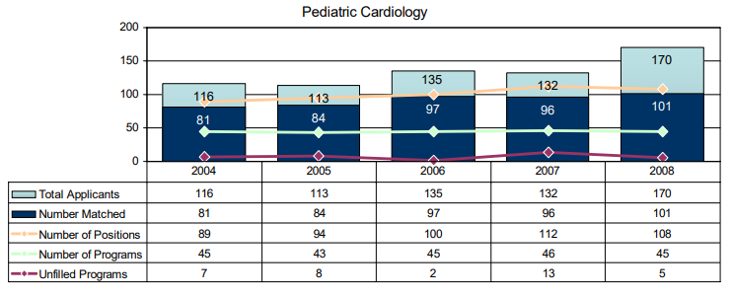
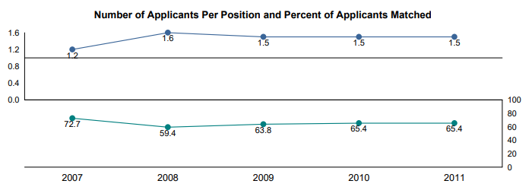
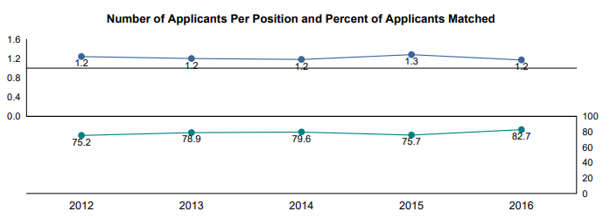
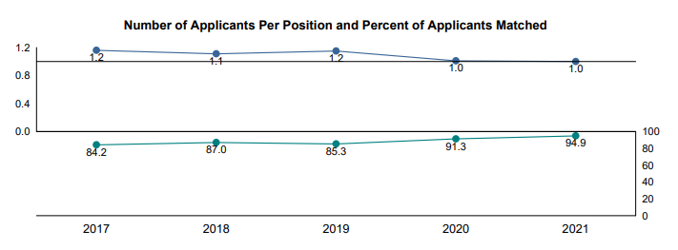

Slide 24
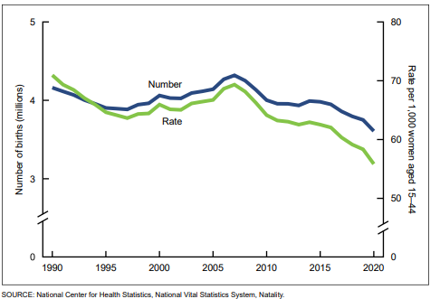

Slide 25
As of today…
65 programs
60 with continued accreditation status
5 with initial accreditation
3 with fellows, 2 without

Slide 26
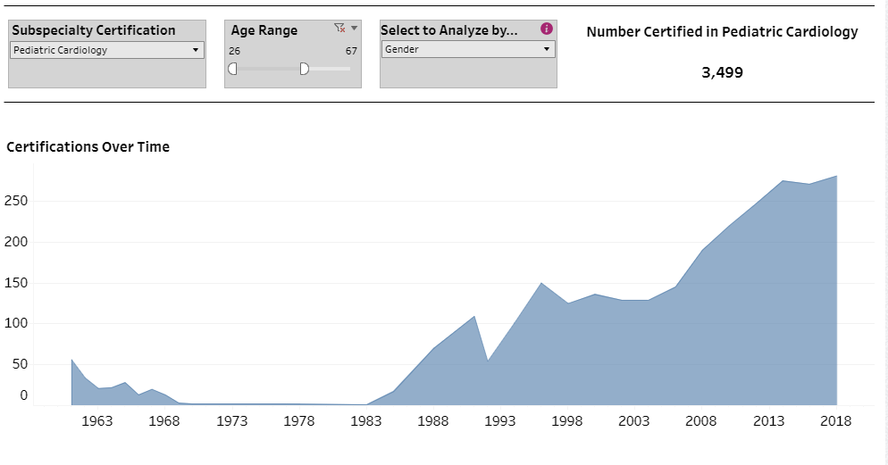

Slide 27
DEI task force
Mixed methods study of virtual interviewing
4th year application process

Slide 28
APPD SPIN is surveying fellowship program directors about Entrustable Professional Activities or EPAs. EPAs describe the essential, routine tasks that a practicing subspecialist is expected to perform.
As you are likely aware, the ABP recently announced that they will begin transitioning towards use of EPAs as part of the assessment framework for initial certification. From this survey, we would like to better understand the barriers and facilitators to using EPAS to assess pediatric fellows and how EPAs are currently being used by fellowships. The survey is VERY brief and should only take about 5 minutes to complete.
Your participation in this study is voluntary. No identifying information about you will be included in the research data.
Questions about the study? You may contact the Principal Investigators, Richard Mink, MD, MACM (rmink@ucla.edu) or Melissa Langhan, MD, MHS (melissa.langhan@yale.edu).
This research study was approved by the John F. Wolf, M.D. Human Subjects Committee (Institutional Review Board) of the Lundquist Institute for Biomedical Innovation at Harbor-UCLA Medical Center.
You may contact the Lundquist Institute Compliance Office at 310.222.3624 if you have questions or concerns about your rights as a research participant.
Your participation is greatly appreciated!
TO COMPLETE THE SURVEY: https://appdlearn.limequery.com/328653?token=evkNmXiVpsh0Pa9&lang=en [appdlearn.limequery.com]
*Please note: If you receive an error message at the end of the survey please ignore. Your submission has been saved.

Slide 29

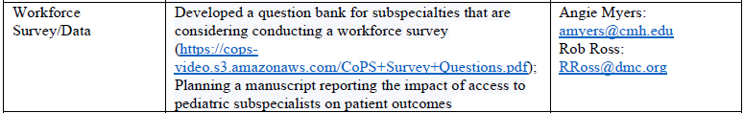
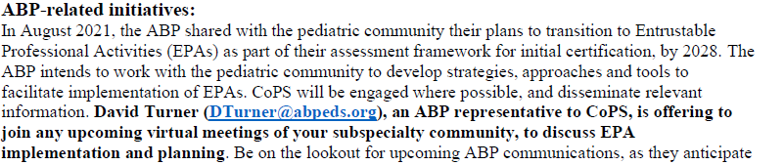

Slide 30

ACGME has determined that peds subs will use:
SBP, PLI, PROF, ICS subcompetencies/milestones 2.0 from general peds
PC and MK from specialties – may create their own
Each subspecialty’s workgroup includes
Rep from the APPD Fellowship Director Section
Rep from CoPs
Each subspecialty may choose to appoint a third “at large” representative
Other representatives will be included (ABP, a public member, etc); ACGME covers all travel expenses; there is some between meeting work, but it is not substantial) or approximately 6 x 2-hour meetings (virtually).
The goal is that drafts of subspecialty specific plans for Milestones 2.0 will be available for Public Comment in fall of 2022, and implementation July 1, 2023.

Slide 31

Next meeting(s)
?

