Slide 1
SPCTPD meeting
Tuesday, February 2, 2021

Slide 2
Agenda
Welcome
2021 NRMP trends
Pediatric Milestones 2.0
4th year application timeline
Common match with adult subspecialties
New SPCTPD fellow liaison
Coaching for PDs
PC-NES planning
ACC planning

Slide 3
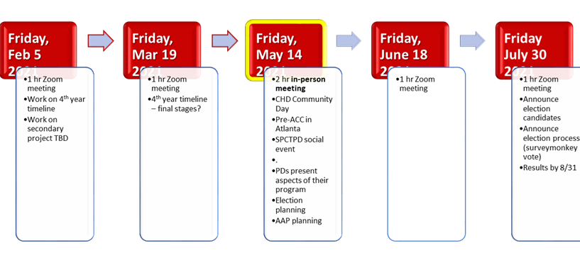

Slide 4
NRMP Trends
Appointment year 2021

Slide 6
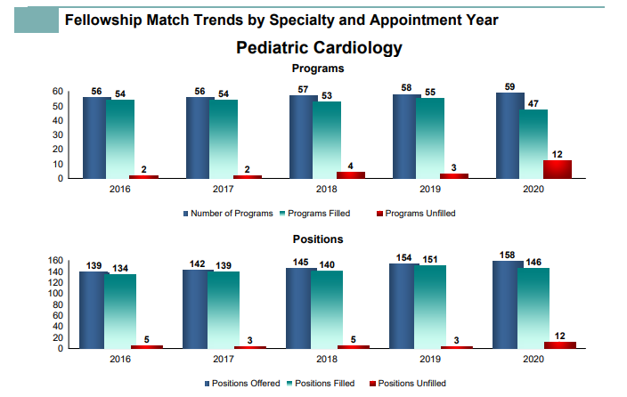
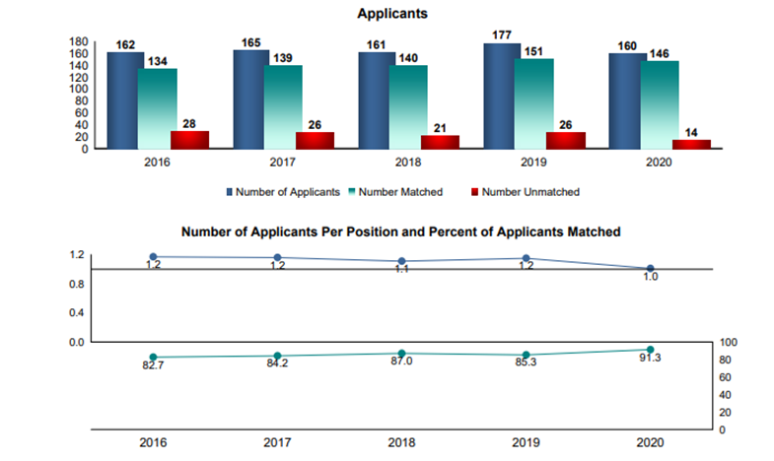
1.0
157:157
94.9

Slide 7
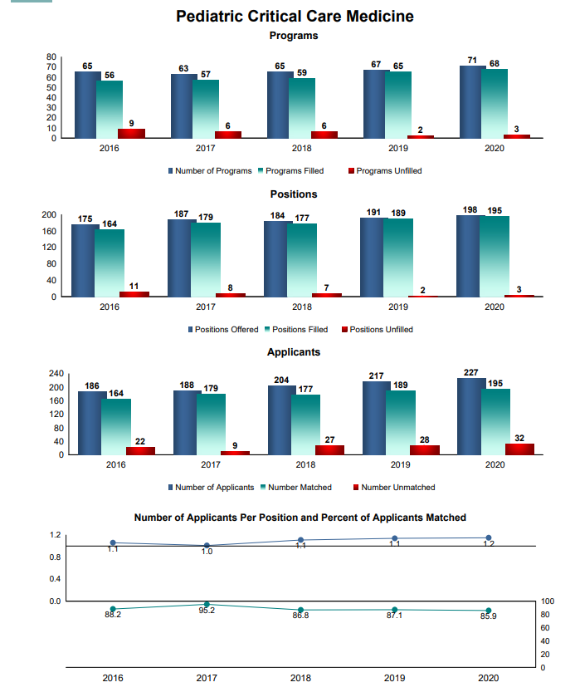
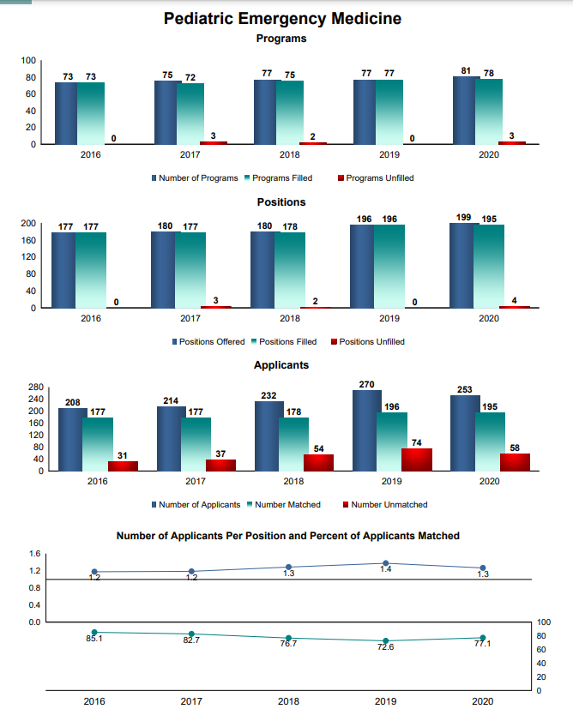

Slide 8
Pediatric Milestones 2.0

Slide 9
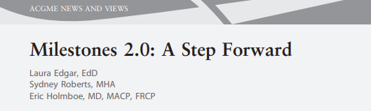
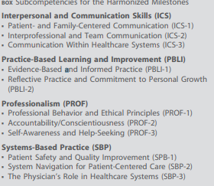
Pediatric milestones 2.0
Concerns about non-PC, non-MK milestones
“Harmonize” ICS, PBLI, PROF, SBP
Reduce complexity
Open for public comment 12/14 – 1/8
Representation from pediatric cardiology community?
“…analysis showed that across the 26 core specialties… there were more than 230 different ways of describing PROF, 171 for PBLI, 176 for ICS, and 122 for SBP”

Slide 10
4th year application timeline

Slide 11
Timeline for 4th Year Interventional Pediatric Cardiology Fellowship
July 1, 2020
October 1, 2020
July 1, 2021
Fellowship Interviews
Begin accepting
applications
Programs can begin
offering positions
Start of Fellowship
*Applicants will be given a minimum of 1 week for a decision to accept or decline the offer. ???
*The timeline does not apply to internal fellowship applicants.

Slide 12
Common match date with adult subspecialties

Slide 13
SPCTPD Fellow Liaison ‘20-’22:
Kristin Bonello
Dartmouth B.A. ‘11
Georgetown M.S. ‘12
Rutgers Robert Wood Johnson M.D. ‘16
Duke Pediatrics ’19
Boston Children’s 2nd year fellow

Slide 14
Beyond Mentoring:
The Importance of Coaching and Sponsorship in Your Fellowship
Katie Berlacher, Julie Glickstein, Frank Silvestry, Salim Virani

Slide 15
Faculty
Katie Berlacher, University of Pittsburgh Medical Center
Julie Glickstein, Columbia University Medical Center
Salim Virani, Baylor College of Medicine
Frank Silvestry, University of Pennsylvania/Perelman School of Medicine
Staffed by Kristin West and Jacob Crouse from ACC!!
Notes:
Drs. Berlacher, Glickstein, Silvestry and Virani will lead us through a discussion defining coaching and sponsorship, identifying the benefit of doing them regularly in your fellowship, and most importantly providing examples of coaching and sponsoring that you can try in your program immediately after the event.
This will be an interactive event where we break into small groups for a short period during the session to share ideas and brainstorm, returning to a larger group discussion. We will give you key takeaways at the end of the session as well as a collated list of activities PDs and APDs are doing throughout the nation that you can try at your home institution.
When you register, we will ask you to provide one example of coaching and one example of sponsoring that you do already in your program with your FITs.
For the purposes of this request, please use the following brief definitions and examples to guide your response to our request:
“Coaching” is the act of instructing or directing an FIT on a larger task or skill related to their professional development or performance.
Examples include
Guiding them through their first job search with resume writing, interview practice and negotiation skills
Providing help from outside the division to work on interpersonal interactions, professionalism, or communication skills
“Sponsorship” is the act of using influence to pull an FIT up the career ladder
Examples include
Writing a LOR and making a personal call for an FIT when they apply for ACC/ AHA committees
Sending email to division and posting a tweet about an FITs published poster/paper

Slide 16
What will you be able to do by the end of this webinar?
Define coaching and sponsorship as it relates to fellowship
Provide examples of both
Commit to one new way of coaching and sponsorship that you will attempt in your program
Notes:
Date set for 1/21 at 630p and should be 75 minutes max. Participants will pre-register and we will assign then to breakout groups beforehand and designate a leader for each breakout to take notes and report out on what the group discussed. Each group will also receive designated questions to discuss in their breakout. Leader will receive these the morning of webinar. Leader will send notes from the group to KW after the webinar. We will compile all notes to share with all participants.

Slide 17

Our gift to you at the end of the hour… a list of good ideas!

Slide 18
Mentorship…
A longitudinal personal relationship where experienced person (mentor) provides advice, feedback, guidance to another less experienced person (mentee)
Notes:
Advise: on a specific event, in a targeted area, directed by you, give advice or answer, single session
Coach: on a task or skill, applies broadly, directed by learner, ask clarifying questions to help learner find strategy, short term
Mentor: on career or research, largely mentor directed with input from learner, repeated interchanges, long term
Sponsor: to use influence to pull someone up the career ladder; to advocate for a more junior person
Focus on invitations, assignments or roles that can be documented on CV
Has been associated with success
Note gender and race gaps in sponsorship

Slide 19



Good mentorship is associated with:
improved personal development
better academic career path
more research productivity
higher career satisfaction
Notes:
Hence the need to go “beyond” mentoring

Slide 20
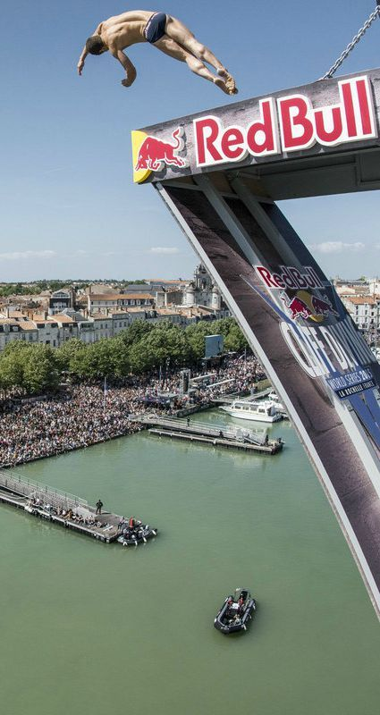
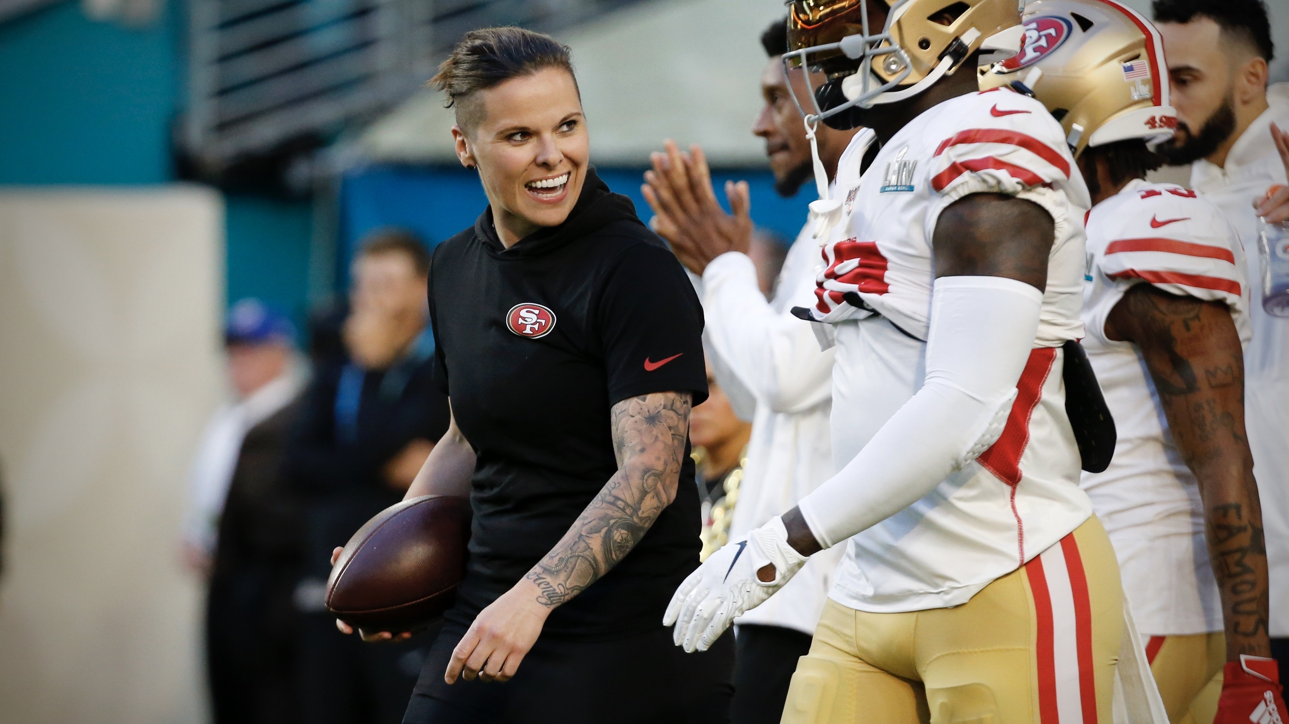

Coaching and Sponsorship
Notes:
Coaching – sports
Katie sowers
Sponsorship – business –sponsor an event like the Olympics – although we also see companies sponsoring people – which is a bit closer to what we’ll discuss
Sponsorship of a person in business - active support by someone appropriately placed in the organization who has significant influence on decision-making processes or structures and who is advocating for, protecting, and fighting for the career advancement of an individual

Slide 21


Coaching is…
The act of instructing or directing an FIT on a larger task or skill related to their professional development or performance
Notes:
“Coaching” is the act of instructing or directing an FIT on a larger task or skill related to their professional development or performance.
Examples include

Slide 22
Examples of Coaching
Guiding an FIT through first job interview with resume writing, interview practice, negotiation
Hiring a communications coach for FIT who is always perceived as “blunt” by others in hospital
Notes:
Guiding them through their first job search with resume writing, interview practice and negotiation skills
Providing help from outside the division to work on interpersonal interactions, professionalism, or communication skills

Slide 23
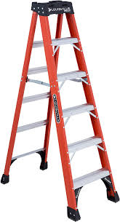
Sponsorship is…
The act of using influence to pull an FIT up the career ladder
Notes:
“Sponsorship” is the act of using influence to pull an FIT up the career ladder
Examples include
Writing a LOR and making a personal call for an FIT when they apply for ACC/ AHA committees
Sending email to division and posting a tweet about an FITs published poster/paper

Slide 24
Examples of Sponsorship
Writing a LOR to recommend FIT for ACC committee
Suggesting an FIT as a speaker for local community event
Notes:
Writing a LOR and making a personal call for an FIT when they apply for ACC/ AHA committees
Sending email to division and posting a tweet about an FITs published poster/paper

Slide 25
Why should you do this?
It’s the right thing to do.
It makes you look good as PD.
It may alleviate you from some work.
Let’s be honest – you don’t have to do all of this. Train your faculty and delegate!

Slide 26
Small Group Break Out Sessions
Break out into 5 separate groups/ 10-15 people in each group, for 20 minutes (5-minute warning when we will reconvene) . You should have received your group number prior to this webinar. Each group has 2 categories of questions, with 2-4 questions in each category. Categories with questions will be posted in the chat.
  Group 1: Category 1,2
  Group 2: Category 2,3
  Group 3: Category 3,4
  Group 4: Category 4,5
  Group 5: Category 5,1
Nominate a person in your group, who will be the “ official “ notetaker. This person will report back each individual group’s findings to the entire session, once we reconvene. Goal: to maximize collaboration, participation and input, and share everyone’s ideas.

Slide 27
Questions for Discussion
Category 1: How do you teach/ encourage faculty development on the topic of sponsorship and coaching of fellows ?
  How do you leverage cardiology faculty outside your program or institution in helping to coach and sponsor fellows?
  How do you incorporate non cardiology faculty/resources from different graduate schools to help with sponsorship and coaching of your fellows?
  How do you include alumni faculty and peers in helping coach and sponsor fellows?
  Consider : Importance of Letters of recommendation for fellows/ nominate them for roles in major professional organizations
Category 2: What are barriers to sponsorship and coaching of fellows ?
  How do you help fellows define personal and professional goals?
  How do you coach/sponsor people with different life experiences?
  What was something that didn’t work?
  How do you “match” faculty with fellows ?
Category 3: Where do you find resources for activities that assist with sponsorship and coaching of fellows?
  How do you leverage social media for coaching and sponsorship?
  How do you encourage faculty to partner with fellows and co- author chapters, review articles or review of peer article submissions for journals ?
Category 4: How do you evaluate your program’s progress/success with sponsorship and coaching of fellows?
  How do you get buy in from fellows ?
  How do you determine what your fellows might be interested in regarding sponsorship and coaching ?
Category 5: What are Non-Academic Coaching and Sponsoring Opportunities that you can take advantage of ?
  How do you leverage local meetings in your city/ or geographic area to showcase fellows ?
  How to determine which major cardiology organizations have leadership or committee positions
  for FIT?

Slide 28
Questions for Discussion
Category 1: How do you teach/encourage faculty development on the topic of sponsorship and coaching of fellows ?
  How do you leverage cardiology faculty outside your program or institution in helping to coach and sponsor fellows?
  How do you incorporate non cardiology faculty/resources from different graduate schools to help with sponsorship and coaching of your fellows?
  How do you include alumni faculty and peers in helping coach and sponsor fellows?
  Consider : Importance of Letters of recommendation for fellows/ nominate them for roles in major professional organizations
  Importance of defining coaching and sponsorship to Faculty, faculty development, teaching the faculty how to leverage these tools
    HOW IS MENTORING DIFFERENT FROM COACHING and SPONSORSHIP ?
  Some institutions have resources and some do not - find out if yours does and use them!
  Teach your faculty - take time at a faculty meeting to introduce the concept
  Consider assigning a separate coach and mentor upon fellow’s arrival

Slide 29
Questions for Discussion
Category 2: What are barriers to sponsorship and coaching of fellows ?
  How do you help fellows define personal and professional goals?
  How do you coach/sponsor people with different life experiences?
  What was something that didn’t work?
  How do you “match” faculty with fellows ?
  Deliberate matching of faculty with fellows prior to matriculation for mentorship, coaches, sponsors but also need to allow organic relationships to develop
  House based or team based (more fellows paired to faculty)
  Barriers include time, lack of understanding (definitions!)
  Different lived experiences may be a perceived or real barrier to coaching and sponsoring
    Ask the fellows how they would like to be paired with faculty - include their preferences
  Not knowing where the resources are a barrier
  Q 6 months with PD/APD not best way to define goals
  Recognize goals will change/evolve over time

Slide 30
Questions for Discussion
Category 3: Where do you find resources for activities that assist with sponsorship and coaching of fellows?
  How do you leverage social media for coaching and sponsorship?
  How do you encourage faculty to partner with fellows and co- author chapters, review articles or review of peer article submissions for journals ?
  Use of Twitter to sponsor and promote the work of fellow
  Create Whatsapp group to create a living breathing just in time network - include faculty, fellows, alumni
  Take advantage of Regional and National ACC (and others) activities
  GME and institutional resources if available

Slide 31
Questions for Discussion
Category 4: How do you evaluate your program’s progress/success with sponsorship and coaching of fellows?
  How do you get buy in from fellows ?
  How do you determine what your fellows might be interested in regarding sponsorship and coaching ?
  Fellows are already self motivated and bought in
  Faculty may need more buy in
  Need more data to help determine what needs are and how well we are doing
  Using program reviews
  Creating programs for putting together CV building, job search
  Include alumni !!!

Slide 32
Questions for Discussion
Category 5: What are Non-Academic Coaching and Sponsoring Opportunities that you can take advantage of ?
  How do you leverage local meetings in your city/ or geographic area to showcase fellows ?
  How to determine which major cardiology organizations have leadership or committee positions for FITs?
  National ACC committees are hard to obtain - focus on local chapters and other local activities to sponsor fellows
  Coaching on how to present
  Invited speakers for GR- meet with fellows!!!!
  Bring in local experts to teach coaching and mentor

Slide 34
PC-NES planning
ACC planning

