Slide 1
SPCTPD meeting
Wednesday, March 31, 2021

Slide 2
Agenda
Welcome
Educational opportunities
Stanford Incoming Fellow Bootcamp
CHA webinar: “Clinical Research: The People Who Inspired Me and Their Tips!”
Updates from last meeting
Proposed common match with internal medicine subspecialties
Pediatric Milestones 2.0
4th year fellowship survey/availability
Update on 4th year application standardization
Progress in Pediatric Cardiology fellow research/QI competition – Rob Ross
Program presentation - professionalism lecture series – Julie Glickstein
ACC/CHD Community Day - programming for you and your fellows – Susan Etheridge
SPCTPD finance update –Susan Etheridge
AAP planning

Slide 3
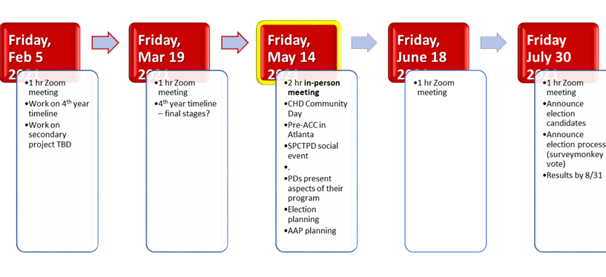

Slide 4
Educational opportunities
Stanford Incoming Fellows Bootcamp
Virtual for second year in a row
Curriculum includes:
Module 1 - Normal Cardiac Anatomy
Module 2 - Heart Sounds
Module 3 - Murmurs
Module 4 - Basics of Echocardiography
Module 5 - Normal Echocardiography Views
Module 6 - Cardiac Catheterization Hemodynamics Part 1
Module 7 - Cardiac Catheterization Hemodynamics Part 2
Module 8 - Cardiac Catheterization Practice Calculations
Module 9 - Emergencies in the CVICU
Module 10 - CVICU Rhythm Management
Module 11 - Cardiopulmonary Bypass
Module 12 - Introduction to Ventricular Assist Devices
Module 13 - VAD Complications
Module 14 - Pediatric Pulmonary Hypertension
Module 15 - Introduction to ECG Part 1: Basic principles
Module 16 - Introduction to ECG Part 2: How to read an ECG
Module 17 - Introduction to ECG Part 3: Practice ECG Reading
Module 18 - Introduction to Pacemakers and Implantable Cardioverter Defibrillators
Email Kara Motonaga sachie@stanford.edu by Wed April 21
Congenital Heart Academy Webinar
Clinical Research: The People Who Inspired Me and Their Tips!
Thursday April 1st 2021, 11:00-12:30 Eastern USA Time
Register: http://bit.ly/GW-CHA
Drs. D’Udekem and Wernovsky will be discussing the process of starting and sustaining a career in clinical research with an emphasis on pediatric cardiovascular disease. They look forward to sharing tips they have learned along the way from their mentors and colleagues, as well as their own lessons learned. Please join us as we #payitforward.

Slide 6
Updates
Proposed common IM/peds subspecialty match
All peds subspecialty fellowships except cardiology are okay with a common date, even if it means moving two weeks earlier
Meeting between SPCTPD board and Richard Mink/Jill Fussell pending for next week
Pediatric milestones 2.0
Reached out to ACGME and ABP about peds cardio input
No PC on this project, though subspecialty milestones are separate

Slide 7
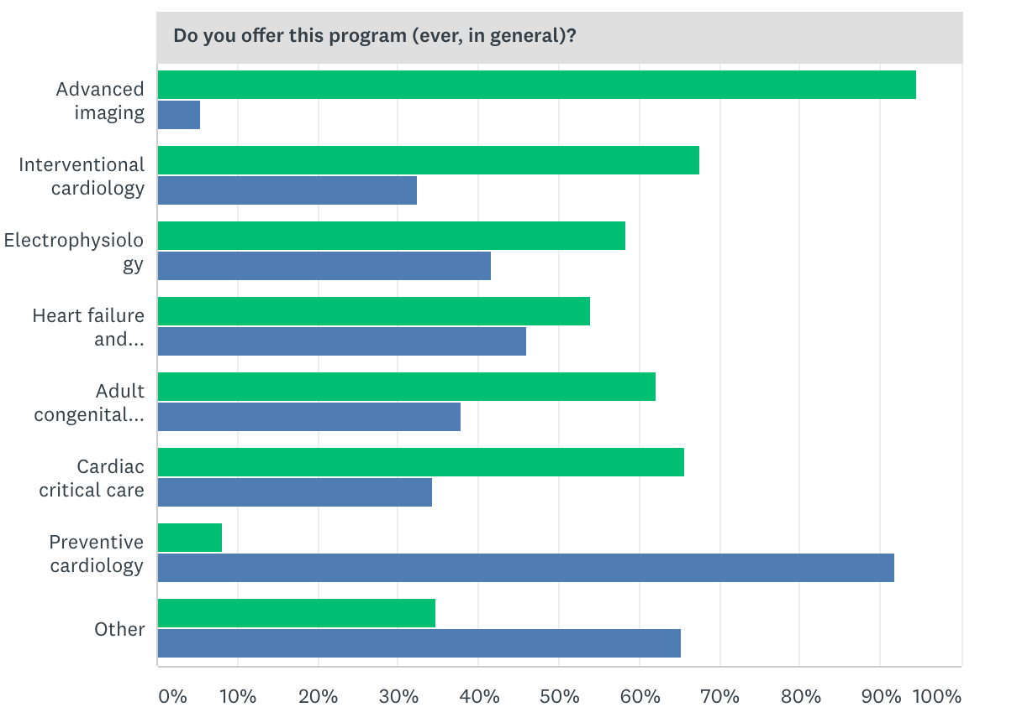
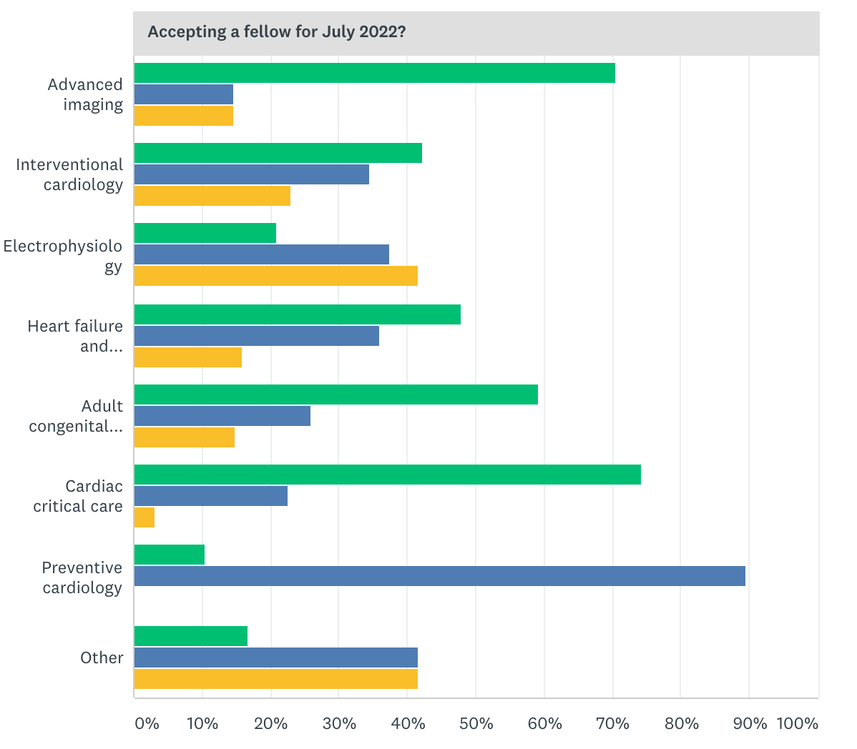
4th year fellowship availability
63 ACGME-accredited active fellowships
58 responses (no response: UT Houston, Riley Children’s, JH All Children’s, U. Wisconsin-Madison, Helen DeVos Children’s)
46 associate PD contacts
67% (n = 39) of programs offer 4th year training
For the 1st time, contact info for most subspecialty fellowships

Slide 8
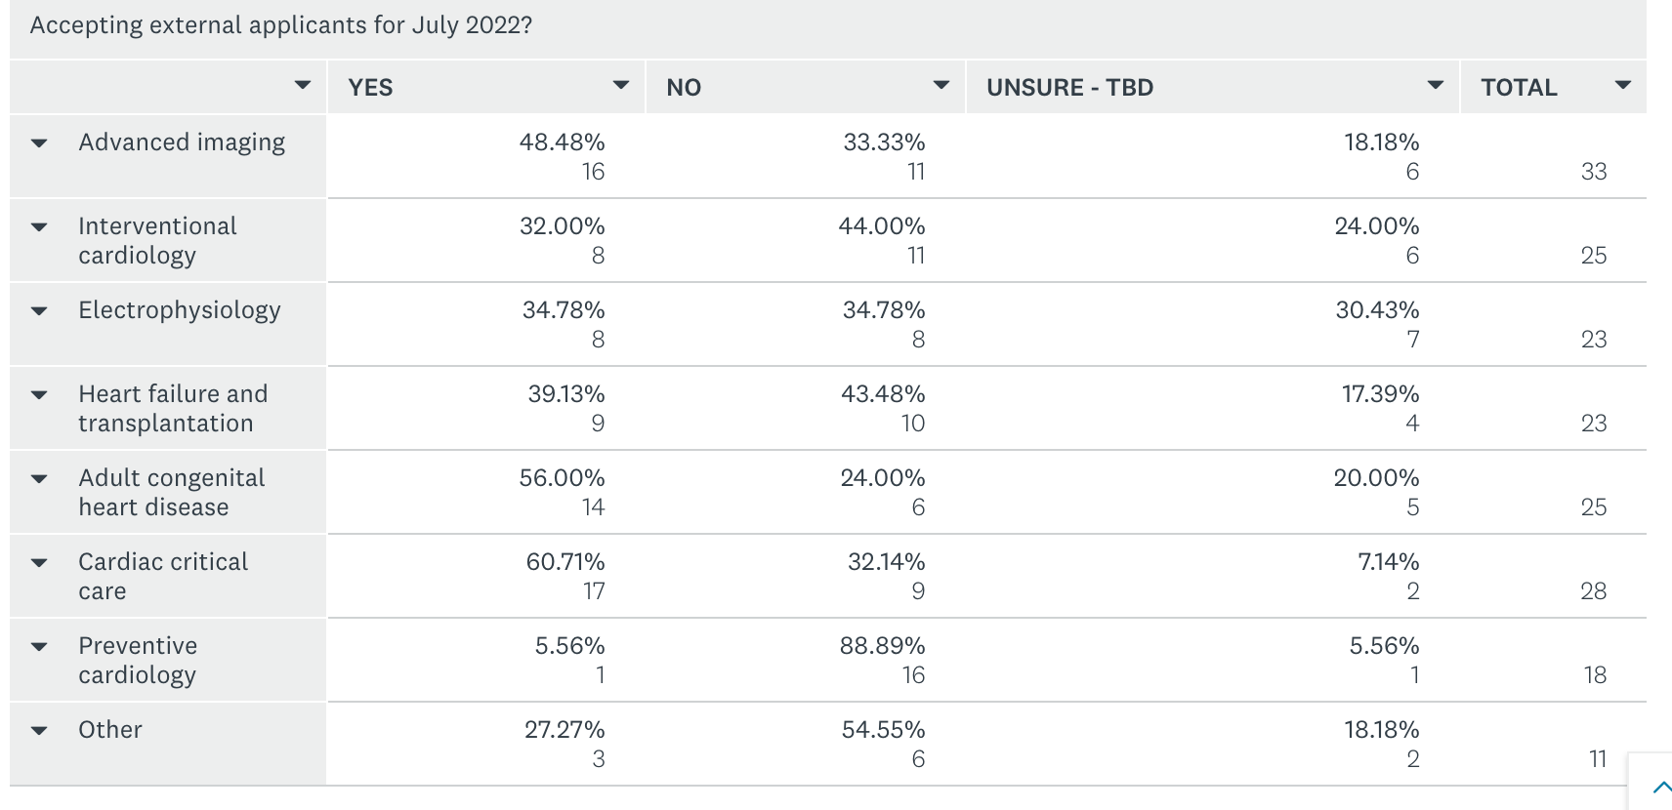
4th year fellowship availability

Slide 9
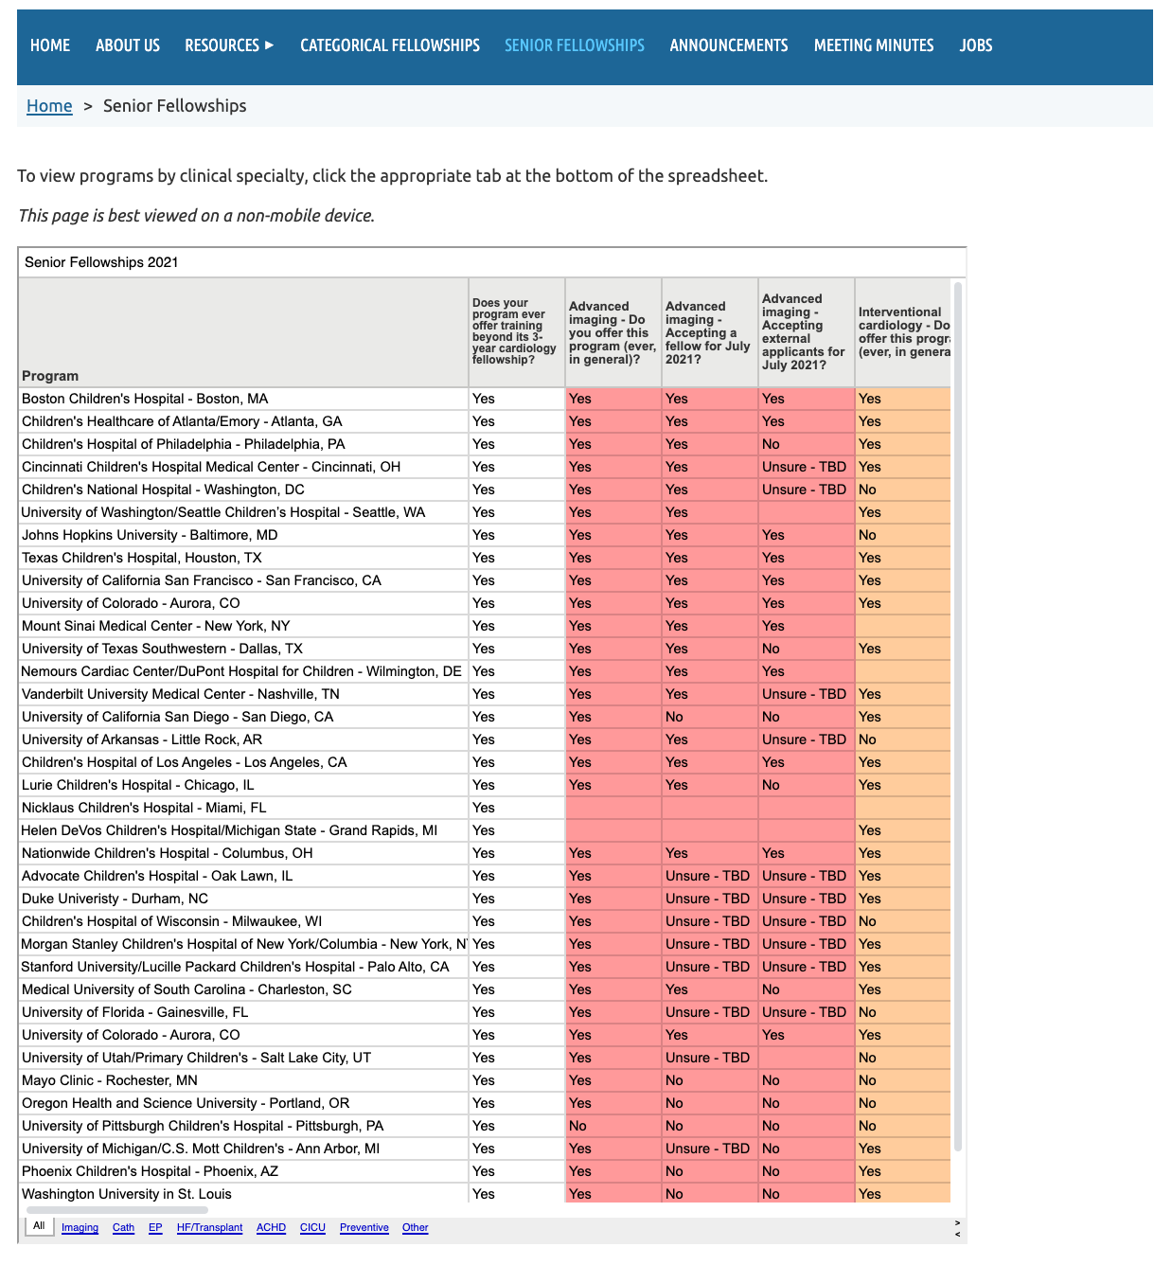

Slide 10
4th year application standardization
Handshake agreement
SF match
NRMP
July 1, 2020
October 1, 2020
July 1, 2021
Fellowship Interviews
Begin accepting
applications
Programs can begin
offering positions
Start of Fellowship

Slide 11
4th year application standardization
Imaging
Ongoing discussions with SOPE
SOPE willing to officially endorse, not in favor of NRMP
Strongly favor opt out for internal candidates
Cath
Recently spoke with group of interested interventionalists
Strong interest in increased transparency, interest in adding info to our senior fellowship webpage
Cautiously in favor of some standardization, likely handshake over match
EP
Had Zoom meeting with PACES board
Follow up meeting with all EP 4th year directors pending
Early impression is generally quite positive (handshake vs. SF match)
CICU

Slide 12
4th year application standardization
Realistic goals and unintended (positive) consequences
Make all (most?) stakeholders aware of:
SPCTPD as a resource/partner in subspecialty training
Goal of standardized process
Plan for future meeting of SPCTPD with other educational subcommittees as ongoing tradition at national meetings?
Year 1 (FY21)
Increased use of SPCTPD.org
Vetting of info from subspecialty representatives
Collection of 4th year PD info
Year 2 (FY22) – aim for standard process for fellows starting July 2023

Slide 13
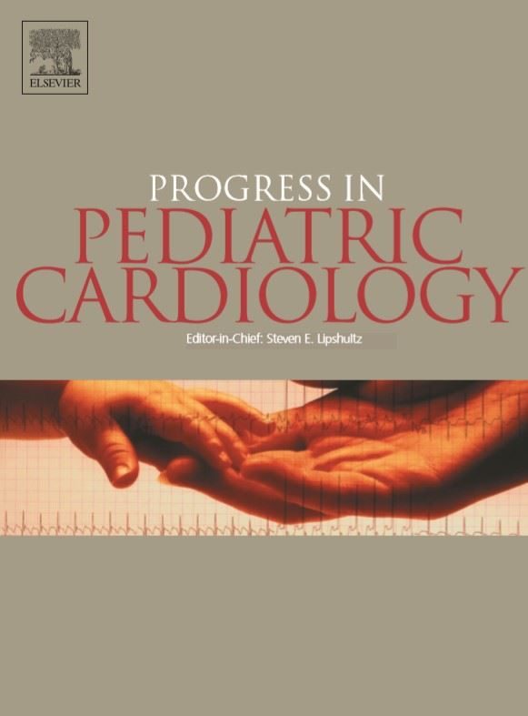
Progress in Pediatric Cardiology

Slide 14
Professionalism Lecture series
Julie Glickstein MD
Program Director Pediatric Cardiology Fellowship Columbia University

Slide 15
Fellowship Education
Clinical Experience
Research Experience
Evaluative Experience (CCC)
Mentoring/ Professionalism/ Wellness

Slide 16
Mentoring/ Professionalism/ Wellness
Peer Mentoring House System
Formal peer to peer mentorship program with three fellows per house (1st,2nd,3rd year fellows)- training how to go from a peer mentee to a peer mentor. Now in year 7.
Clinical rotation check-ins
Preparation of complex patient management conferences
Buddy call
Preparation for jobs, interviews, personal statement writing
Social events (wellness)
Professionalism (everything you might need to know about being a pediatric cardiologist that is not a clinical didactic lecture)
Friday lunch lecture series where we met on the first, second and third Fridays of the month
First Friday: Working lunch- problems or concerns about their day-to-day life are brought up, and new ideas are born and implemented, review leadership position projects, review fellowship QI projects
Third Friday: Lecture series – topics that can be useful for their professional and personal lives
Second Friday: www.azygos.com (4-5 fellows do a 5-minute presentation on an article they read)
Leadership roles in administration, research, education, QI, admissions, fellows' website- (second- and third-year fellows)

Slide 17
Lecture Topics
Resume And Personal Statement Writing
How to Give Bad News
How to Give and Receive Feedback
The Art of Presenting
Professional Resiliency
Parent as Professor Rounds
How Surgeons Counsel Parents pre -op
Telemedicine in your practice
Billing and Coding

Slide 18
Lecture Topics continued:
Stress management 1 and 2 ( arts and crafts led by head of mental health at medical school)
Racism and Health Inequality ( fellow committee)
Narrative Medicine Writing
Financial Literacy Parts 1 and 2: Taxes, budgets, loans, insurances
Spirituality (understanding different faiths and how that affects your families)
How to write a condolence Letter, and dealing with grief in a fellowship
Palliative Care in Pediatric Cardiology
Resolving conflict in team-based situations
How to Deal with Mistakes

Slide 19
Bi-annual Career Night
Biannual Career night: two times a year from 5-7 pm (wine and cheese and invited guests/panel of 4-5 faculty in different stages of their careers)
how to look for a job in academic medicine
balancing out your personal goals with your professional lives
setting early career goals
how to find a mentor
negotiating contracts
things you wish you knew during fellowship
the business of medicine
different career paths- going from your first to your second job

Slide 20
What have you considered doing or have done in your programs that teaches or discusses the “Non-cardiac” topics
Thank You for your time

Slide 21
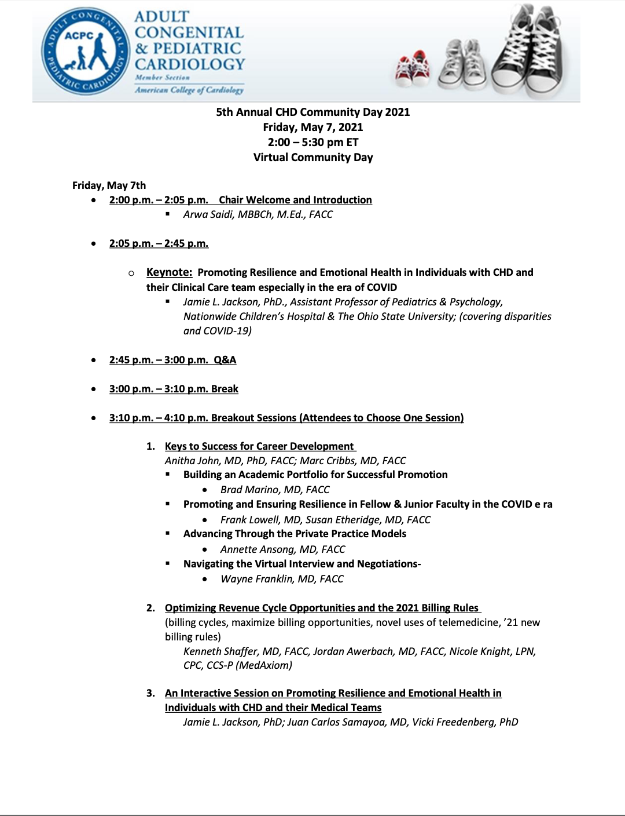
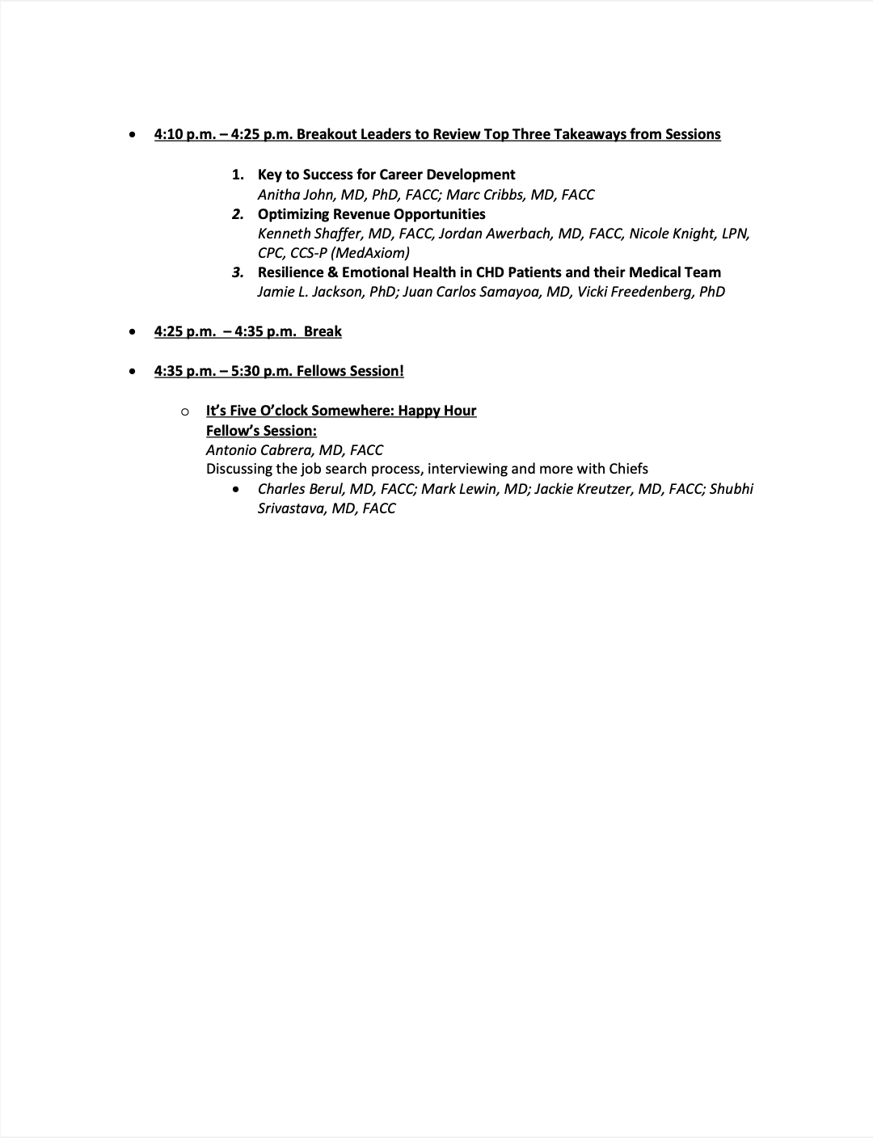

Slide 22
Finance update

Slide 23
AAP planning

Slide 24
Next meeting: TBD in May

