Slide 1
Program Directors Meeting
Winter 2022

Slide 2
Agenda
Welcome… Armsby
ACGME Proposed FTE Changes & SPCTPD response… Rupali
Plans for the upcoming ACC… Etheridge
New Match Dates… Armsby
Recruitment/Interviews 2022… Brown
4th year fellowship survey/listings… Frank
AAP Review Course & ABP Content Guidelines… Armsby
Individual Program Board Review Resources… Armsby

Slide 3
Agenda
Welcome… Armsby
ACGME Proposed FTE Changes & SPCTPD response… Rupali
Plans for the upcoming ACC… Etheridge
New Match Dates… Armsby
Recruitment/Interviews 2022… Brown
4th year fellowship survey/listings… Frank
AAP Review Course & ABP Content Guidelines… Armsby
Individual Program Board Review Resources… Armsby

Slide 4
Current Board
President | Laurie Armsby | OHSU | armsbyl@ohsu.edu
Vice President | Susan Etheridge | Utah | Susan.Etheridge@hsc.Utah.edu
Sec/Treasurer | Rupali Gandhi | IL | Rupali.Gandhi@aah.org
Past President & COPS Rep | Lowell Frank | DC | LFrank@childrensnational.org
Administrator | Lindsay Attaway | DC | Lattaway@childrensnational.org

Slide 5
ACGME Proposed FTE Changes and SPCTPD Response

Slide 6
Alternate proposals
CoPs/APPD:
0-3 fellows: 0.2 FTE
4-6 fellows: 0.25 FTE
7-9 fellows: 0.3 FTE
10-12 fellows: 0.35 FTE
13-15 fellows: 0.4 FTE
0.5 FTE increase for every 3 fellows
Modified:
0-3 fellows: 0.2 FTE
4-6 fellows: 0.3 FTE
7-10 fellows: 0.4 FTE
11-15 fellows: 0.5 FTE
>15 fellows: 0.6 FTE
30 PDs surveyed: 22 preferred the modified proposal, 2 the ACGME proposal, 5 current, 1 CoPs/APPD

Slide 7
SPCTPD Activities at the ACC
Washington, DC;
Friday, April 1- Monday, April 4
Friday, April 1: Community Day, 1-5:00 pm; Marriott Marquis, fellows encouraged
Friday, April 1: Social Hour for Fellows, 5-6:00 pm; Marriott Marquis
Saturday, April 2: Speed dating, 12-1:00 pm; Fellows and faculty (PD volunteers??); Location tba
Saturday, April 2: PD meeting, 4:30-6:00 pm; Marriott Marquis
Saturday, April 2: ACPC section meeting, 6-7:00 pm; Marriott Marquis

Slide 8
Newly Combined Medicine and Pediatrics Specialties Match Dates
Match Registration Opens August 24, 2022
Rank Order List Opens September 28, 2022
Quota Change Deadline November 2, 2022
Rank Order List Certification Deadline November 16, 2022
Match Day November 30, 2022

Slide 9
Interviews/Recruiting post-Covid
Come to consensus regarding our preference for recruitment/interview practice when travel restrictions and infection concerns from the pandemic are no longer an issue.
Share any specific data (surveys, consensus statements, etc.) gathered from our sub-specialty.

Slide 10
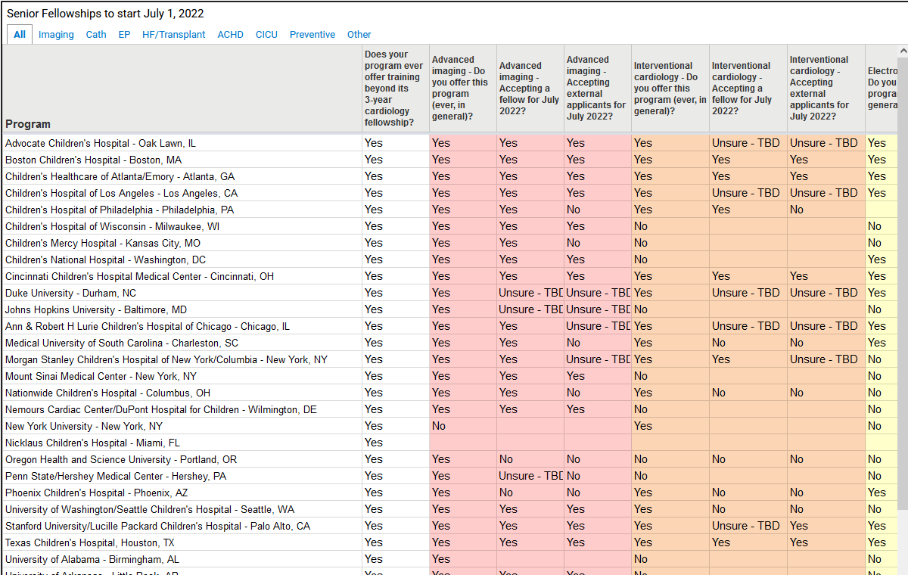
4th Year Subspecialties Fellowship Survey and Listings

Slide 11
4th Year Fellowship Survey
Spring 2020 survey / 2021 July appointment
Spring 2021 survey / 2022 appointment
Spring 2022 survey → 2023 appointment
Addition of APD contact info
Addition of 4th year PD contact info
Will send to both categorical PD and subsp. PDs
Engaged with SOPE, PCICS, PACES, cath
CICU common application and timeline
Will get fellow input about process (???)

Slide 12
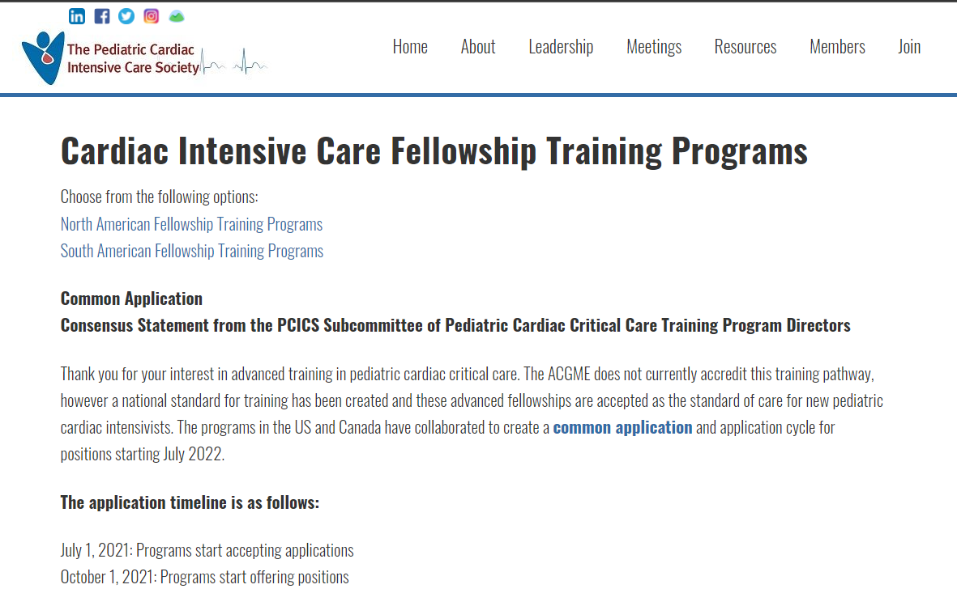
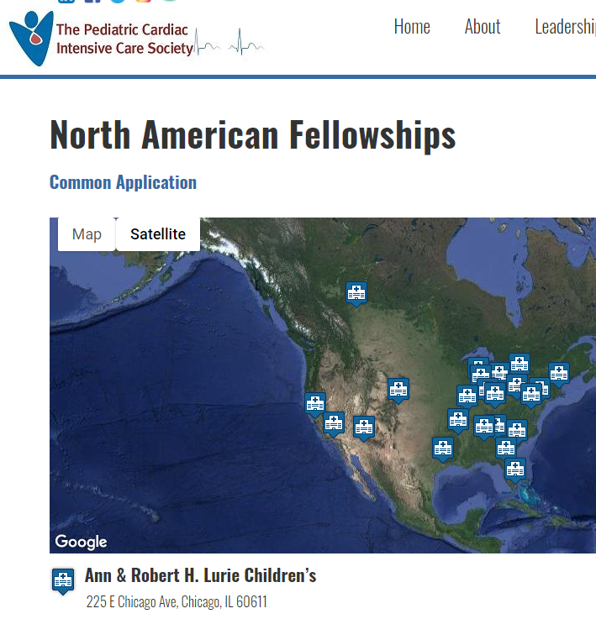

Slide 14
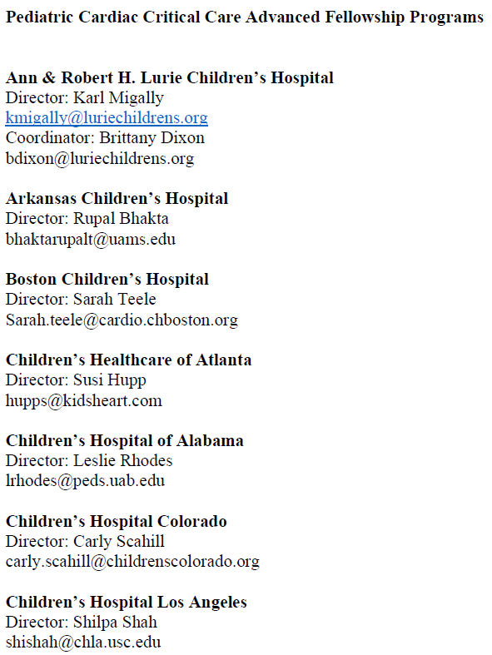
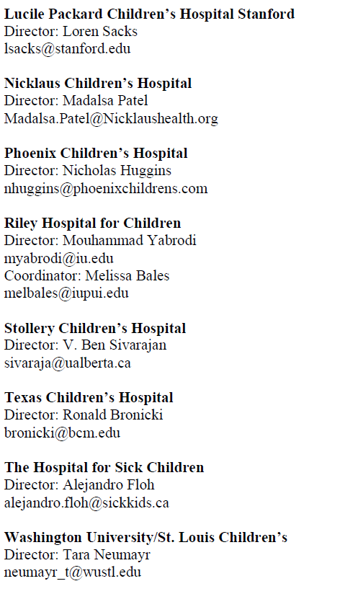

Slide 15
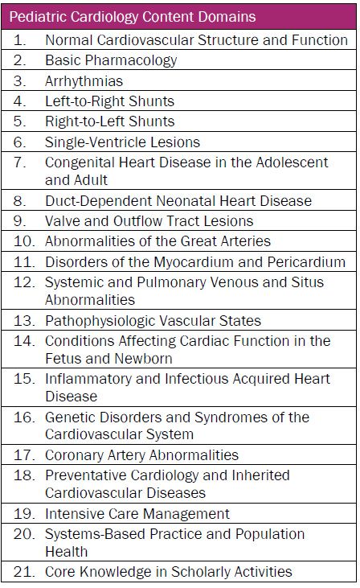
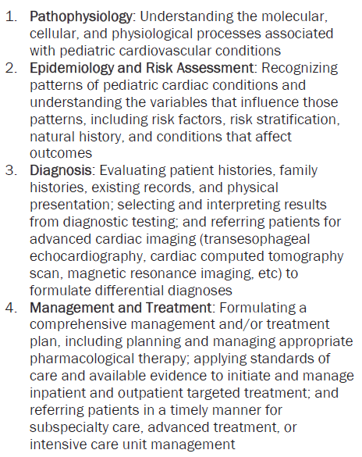

Slide 16
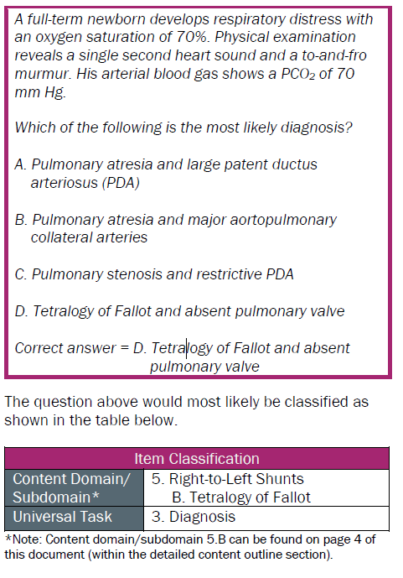

Slide 17
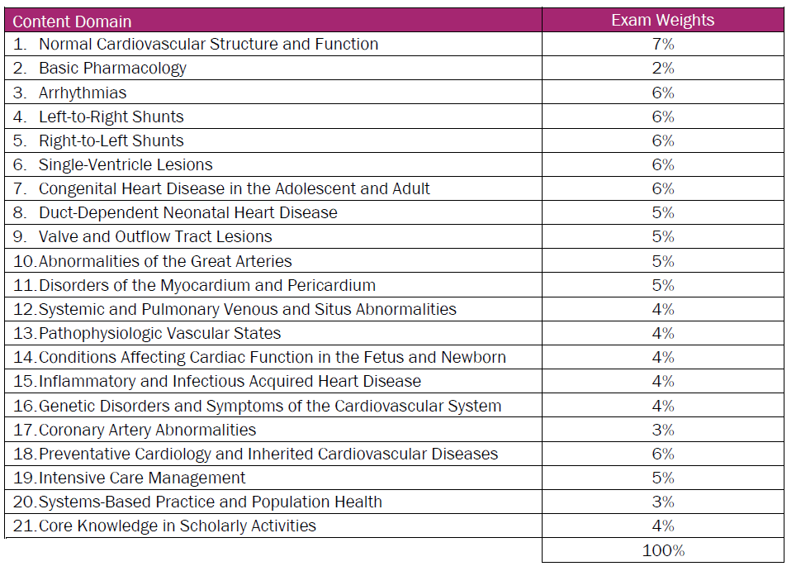

Slide 18
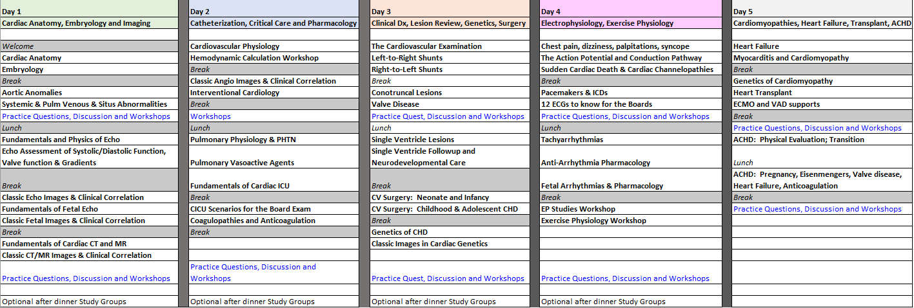
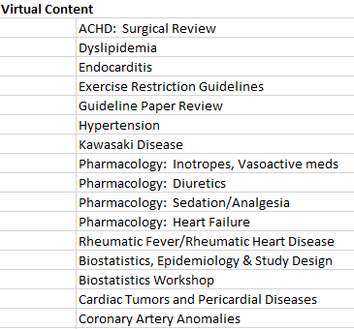
AAP Headquarters
Chicago, IL

Slide 19
Individual Program Board Review Preparation

