Slide 1
How to implement a sustainable QI program in a busy pediatric cardiology fellowship
Julie Glickstein, M.D. FACC, FAAP
Professor of Pediatrics at Columbia University Irving Medical Center
Director, Pediatric Cardiology Fellowship Program
Department of Pediatrics / Division of Pediatric Cardiology
Morgan Stanley Children’s Hospital of New York Presbyterian
jg2065@cumc.columbia.edu

Slide 2
ACGME requirements
The Accreditation Council for Graduate Medical Education (ACGME) 1-year common program requirements¹ include the following:
“Fellows are expected to develop skills and habits to be able to…systematically analyze practice using quality improvement methods, and implement changes with the goal of practice improvement” (IV.A.2.c)
“Fellows must demonstrate the ability to analyze the care they provide, understand their roles within health care teams, and play an active role in system improvement processes. Graduating fellows will apply these skills to critique their future unsupervised practice and effect quality improvement measures.” (VI.A.1.)
“Fellows must receive training and experience in quality improvement processes, including an understanding of health care disparities. (VI.A.1.b).(1).(a)
“Fellows must have the opportunity to participate in interprofessional quality improvement activities.” (VI.A.1.b).(3).(a)

Slide 3
How we set it up at our program (MSCH):
Goals:
Be practical within the confines of our program
QI projects need to be fellow-driven and result in giving fellows functional knowledge and skills for their future QI projects
QI project needs to be deliverable year after year
QI project ( qualitative or quantitative ) must meet ACGME curricular objectives criteria
Limitations:
Program specific inherent Infrastructure
Time Constraints: Fellows have many clinical responsibilities plus research requirements
Major challenges:
July 2014: our fellowship clinic was not as “robust” as it could have been
Lack of diversity of cardiac congenital diagnosis
Continuity of patients in clinic was suboptimal because fellows are only in clinic when not on service
No real “ownership” of patients by fellows and patient “no show rate” for clinic was nearly 30 %
Needed fellowship QI leaders
Needed formal QI education

Slide 4
Timeline: QI projects from July 2014 until the present:
2014-2015: EDUCATION (mine and my fellows)
Learned about QI ( lectures and discussions) from Pediatric Department QI expert
Set up QI infrastructure: 2 QI leaders (July – new project voted on by fellows, quarterly updates, and final written results at end of academic yr.)
Decided that Clinic was a optimal clinical area to initiate QI projects which fellows felt could results in improvements in how health care was delivered
2015-2017: QI Project 1: IMPROVING CONTINUITY OF OUR CLINC PATTIENTS WITH THEIR PRIMARY CARDIOLOGIST
AIM: To improve continuity of patient to fellowship team continuity in clinic
2017-2018 QI Project 2 : IMPROVING THE NO SHOW RATE (saw a stabilization in total no- show rate to ~20%)
AIM : Lower the incidence of no-show and missed follow-up visits to continuity clinic (20%) By working alongside the administrative staff, nurses, technologists and clinic attendings we hoped to improve our patient follow-up
The continuity portion of our project has remained strong with a chart review of April to May 2018 demonstrating 100% follow-up rate of fellow patients seen within 2 years, suggesting that sign-out has been successfully incorporated into the clinic culture. (QI project 1)
2018-2019(20) QI Project 3: UTILIIZE LIFE’S SIMPLE 7 TO INCREASE FREQUENCY AND EFFFECTIVENESS OF CARDIOVASCUALR COUNSELING IN FELLOWS CLINIC (preventative health topic)
2019-2020 Qi Project 4: To be decided

Slide 5
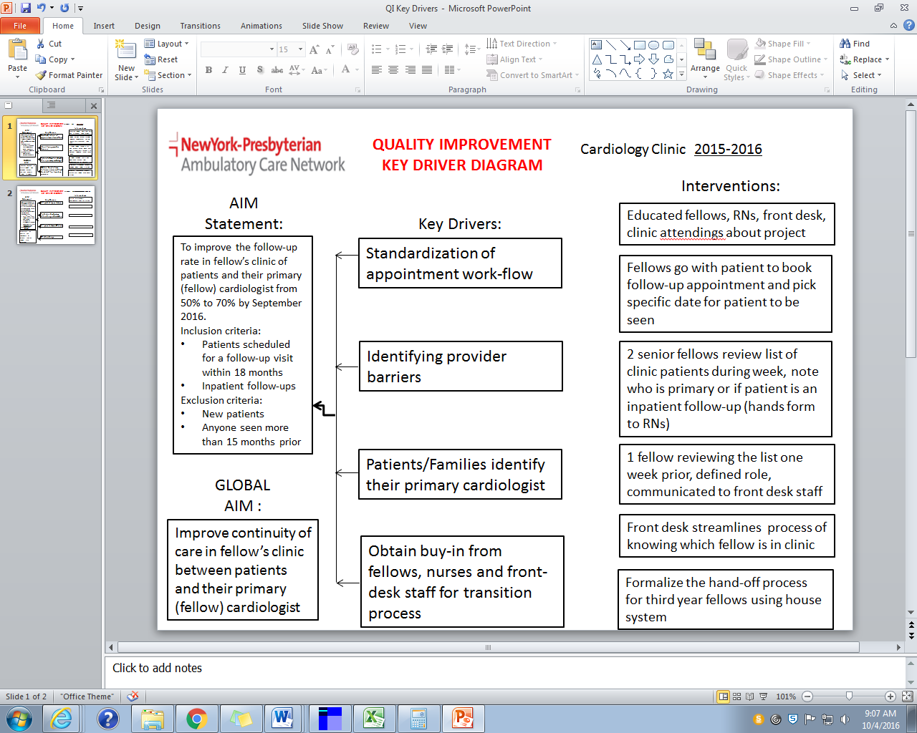
Fellows clinic- 1st QI Project

Slide 6
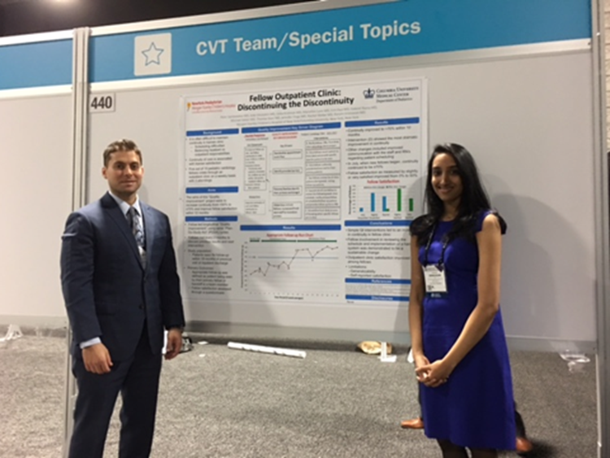
Abstract submitted to ACC:Fellow Outpatient Clinic: Discontinuing the Discontinuity
Authors: Peter Sambatakos, Julie Glickstein, Usha Krishnan, Erin Paul, Gabriel Rama, Michael Satzer, Mariellen Lane, Thomas Starc, Rachel Weller, Ranjini Srinivasan April 2017
Pediatric cardiology fellows can create and lead a system change to rapidly improve primary patient-to-fellow continuity care rates. Sustainable continuity was achieved by working with a multidisciplinary team, and without altering clinical staffing, infrastructure, or trainee work hours.
This project engaged trainees to address the ACGME core competencies of systems-based and practice-based learning, and demonstrated practical application of QI methodology to solve a common clinical problem.

Slide 7
IMPROVING CONTINUITY OF OUR CLINC PATTIENTS WITH THEIR PRIMARY CARDIOLOGIST
WHAT DID WE ACCOMPLISH SO FAR WITH THIS FIRST PROJECT ( abstract presented at ACC, finishing up paper, *******by June 2017 we had a new invigorated fellows clinic )
- A novel process was developed to increase general cardiology patient-to-fellowship physician/team continuity rate in a graduate medical training program
- The creation of a formal hand-off process and new scheduling algorithm resulted in a new culture of continuity (that has been sustained )
- No change in trainee work hours or clinic staffing/structure was necessary to achieve your goal.
- Taught fundamentals of QI methodology in training, and utilized QI to solve a common problem is highly generalizable (real world and training)
- This project addressed/emphasized the ACGME core competencies of systems based and practice-based learning

Slide 8
What did I learn as Program Director …
It is possible to meet all of the ACGME QI requirements delineated in the second slide
QI can be successfully done as a fellowship team sport- they are the stakeholders and it can be deliverable, practical , useful and fit in with their current time constraints
Fellows Clinic can be a great place to incorporate QI learning and projects without taking time away from other rotations; there are many places in a program to implement QI ( peer house system)
Current Fellows have done QI projects during residency and finding two team QI leaders who have experience doing QI is not difficult
We took a “weak aspect” in our program, and use QI to strengthen it and make clinic a more robust learning experience for the fellows
Not every QI project might work out. It is important to initially get “local help” in education and project design
All the fellows have a lot invested in their collaborative QI project…. The “burden” does not fall disproportionately on any one fellow except for the 2nd yr QI leadership fellows.
( all of my second and third year fellows have different leadership positions in the fellowship)
How have you implemented QI in your fellowship programs ? What are some of your ideas??
Role for SPCTPD QI projects as program directors on a national level

Slide 9
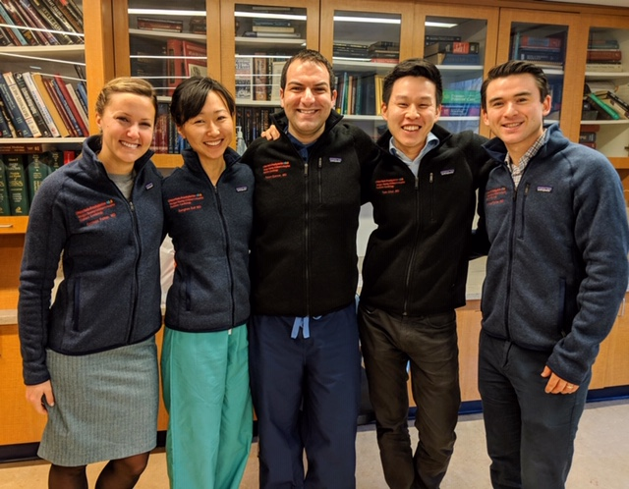
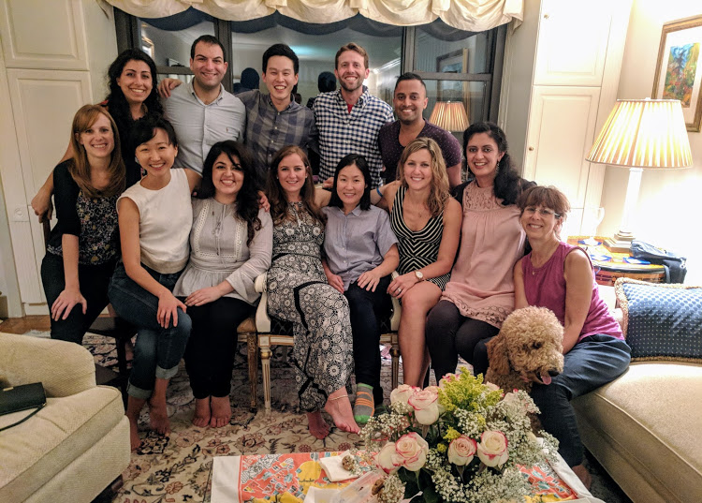
My Fellows 2018-2019

